Slide 1
Applied Deep Learning
Module 6:
Chapter 2
Chapter 11
Notes:
These are notes for the slide

Slide 2
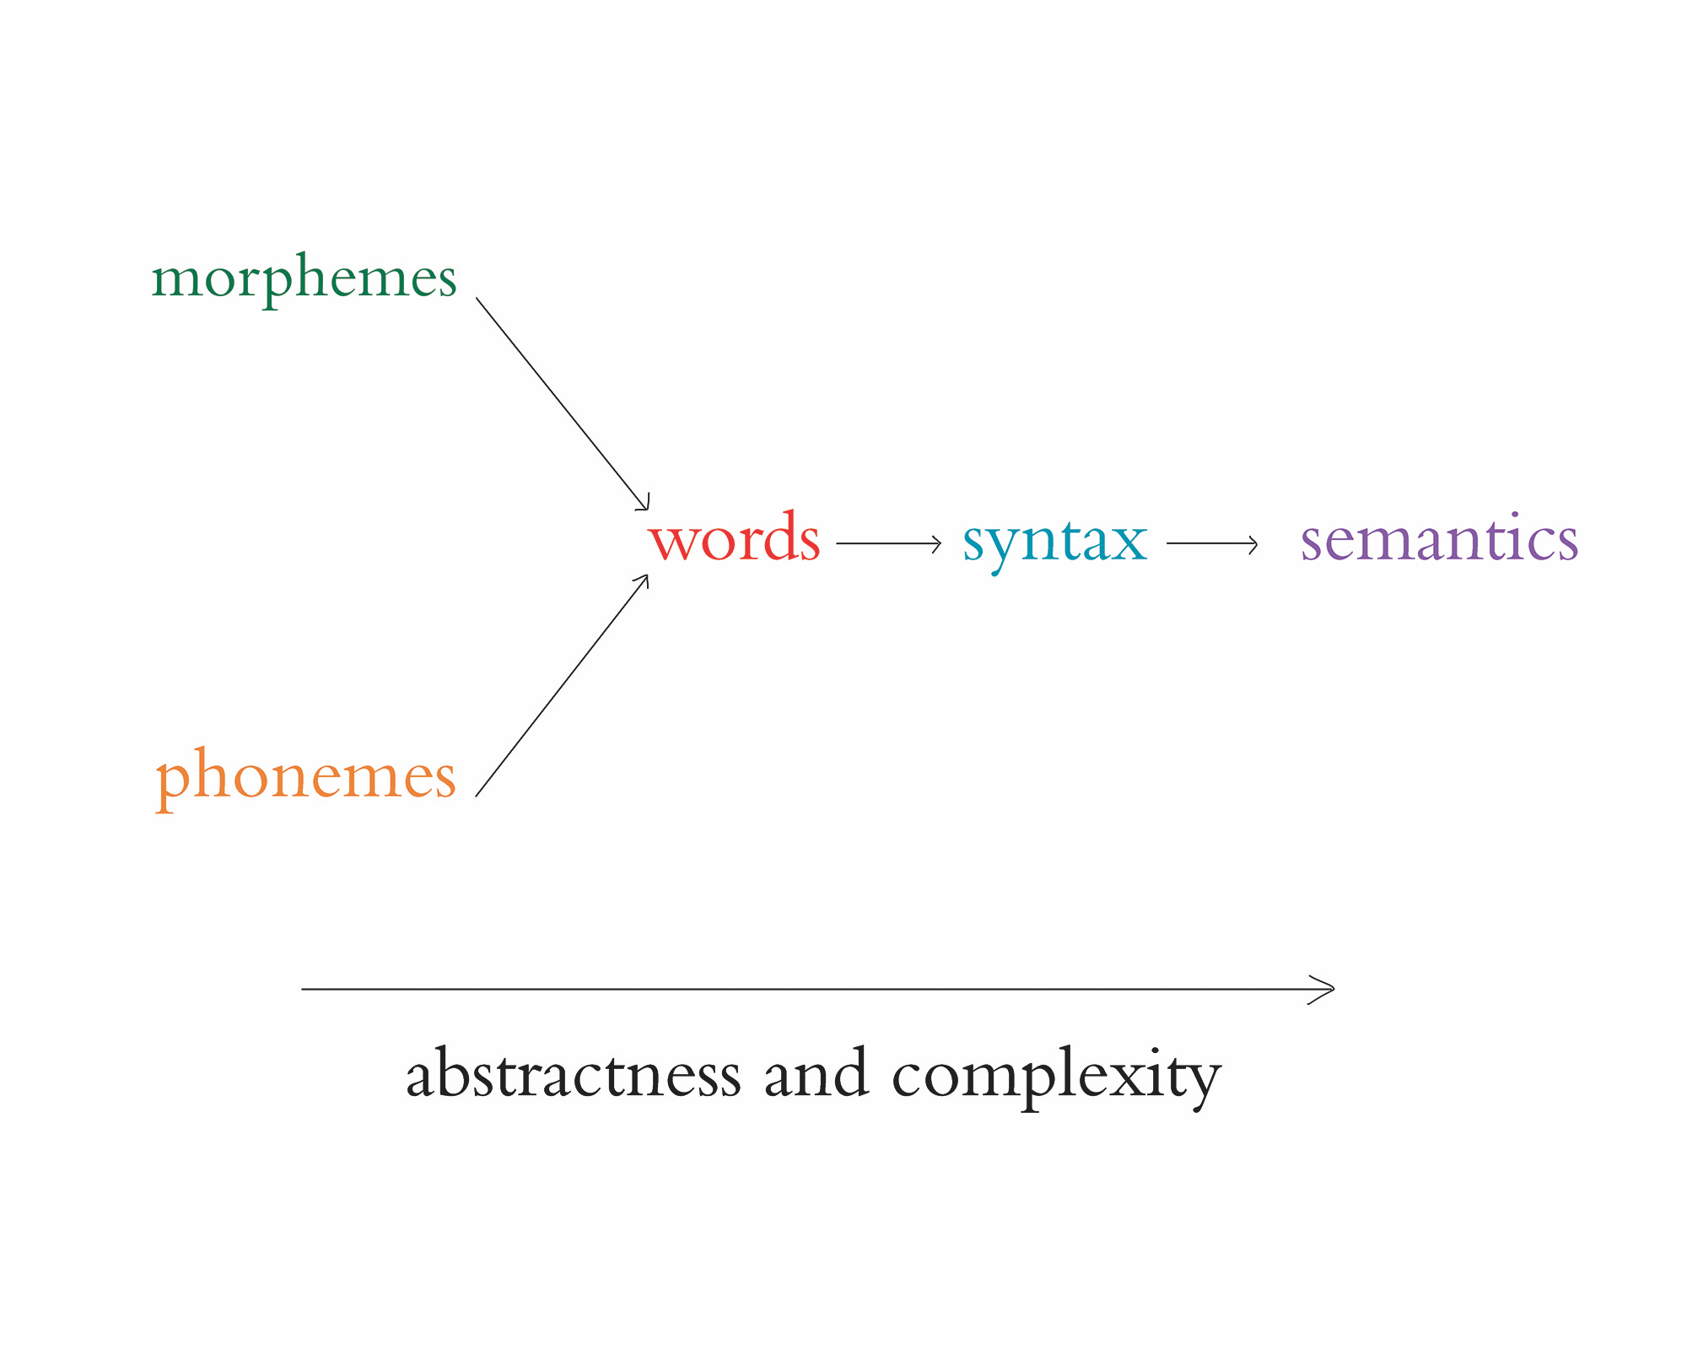
Chapter 2
Human and Machine Language

Slide 3
Two Core Concepts
Deep Learning
Representation learning → learning features from data automatically
Natural Language Processing (NLP)
Taking written or spoken language and processing with machines to accomplish some task

Slide 4
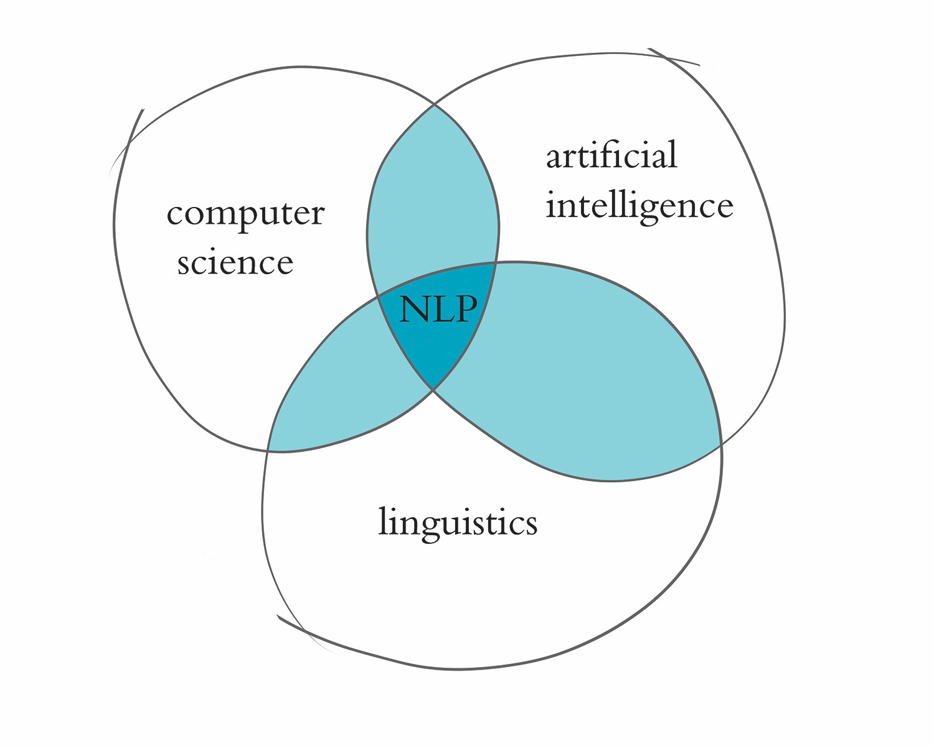

Slide 5
Examples of NLP in Industry
Classifying documents into categories
Machine translation from one language to another
Search engines → autocompleting searches
Speech recognition → interpreting voice commands (Alexa)
Chatbots → machines carrying out natural conversations

Slide 6
NLP Applications
Easy
spell checking
synonym suggestions
keyword search

Slide 7
NLP Applications
Intermediate
reading level
extracting information
predicting next words
classification
sequence generation
time series analysis

Slide 8
NLP Applications
Complex
machine translation
question-answering
chatbots

Slide 9
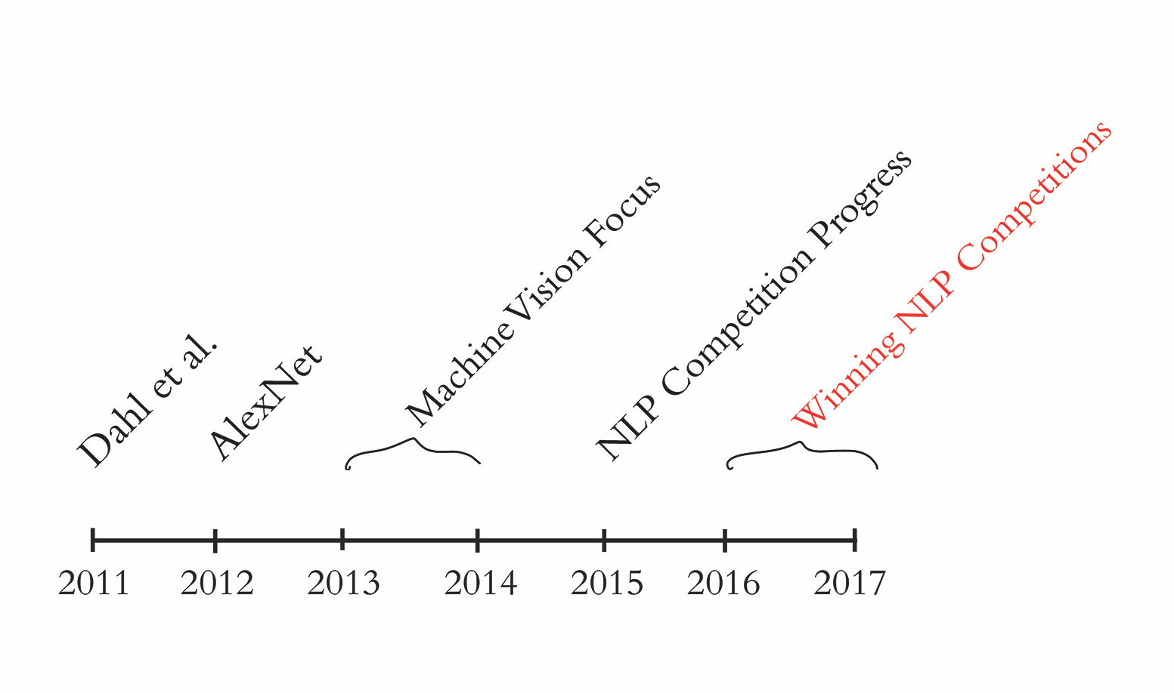

Slide 10
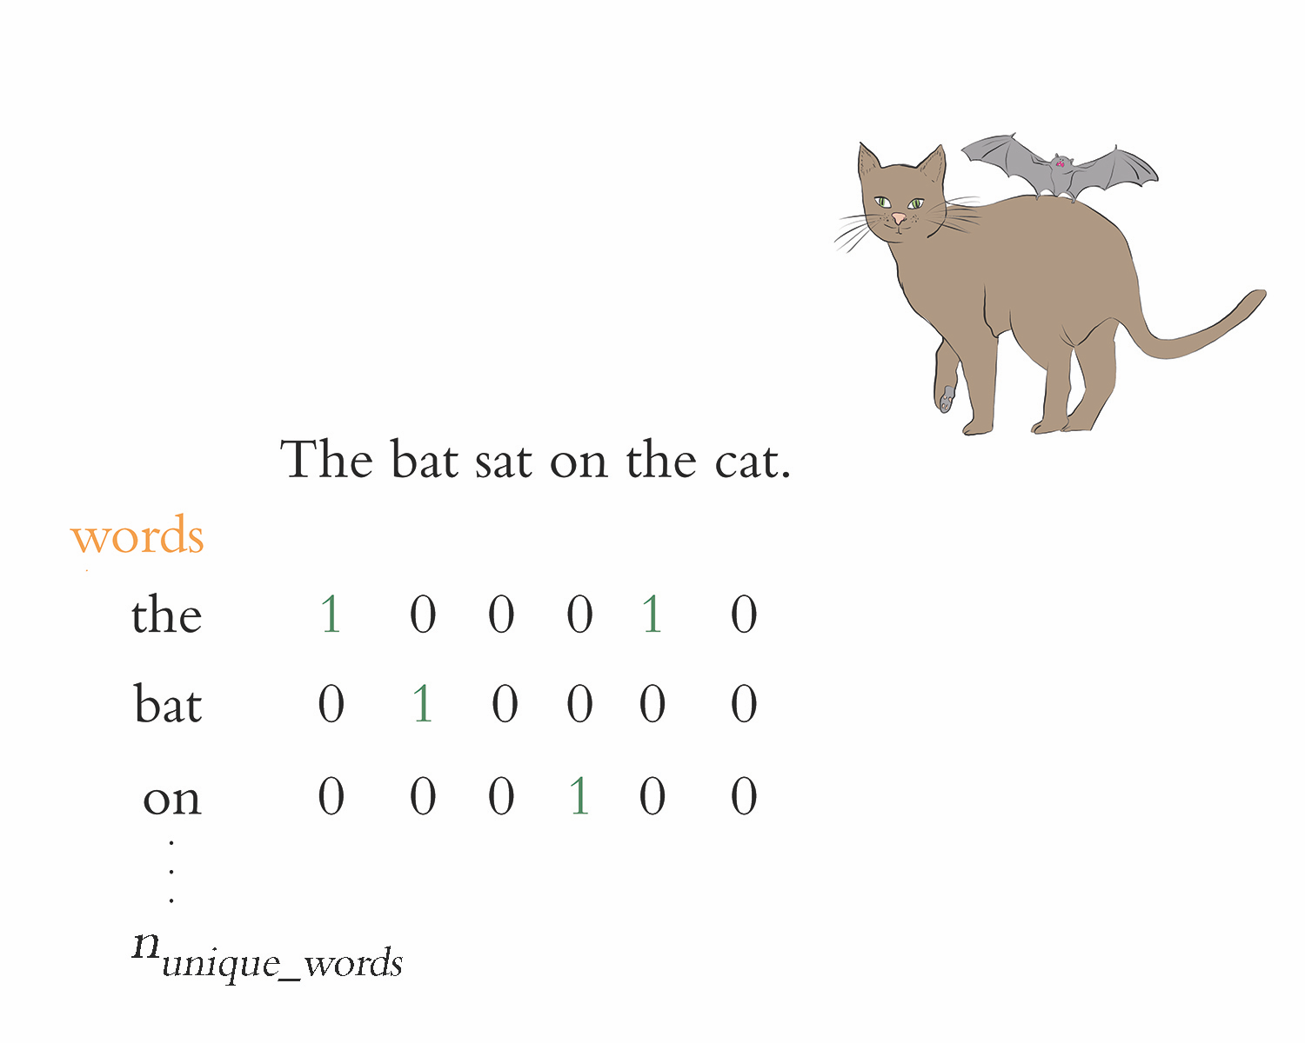

Slide 11
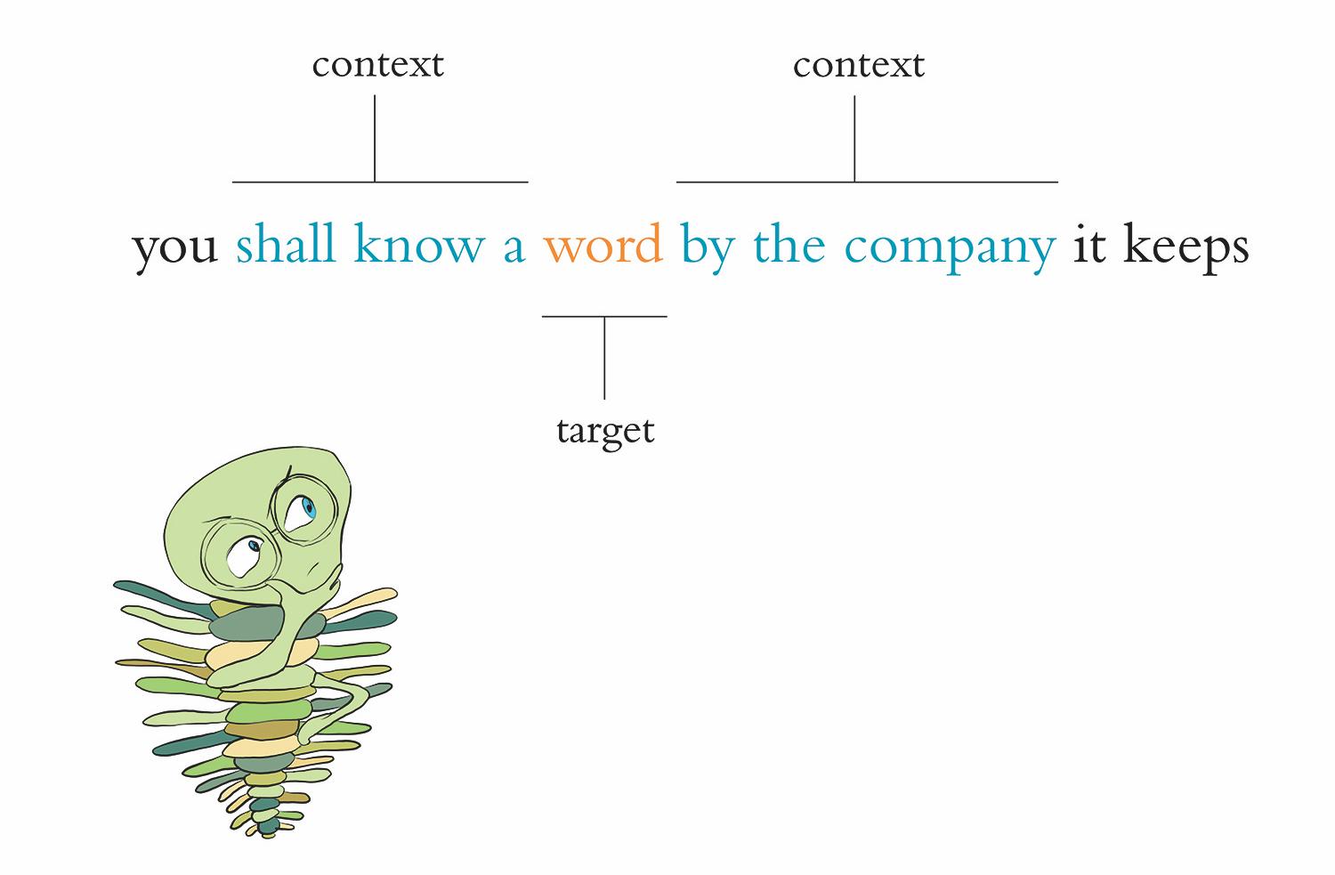

Slide 12
Popular Vectorization Techniques
word2vec
GloVe
Idea is to predict target word given its context words OR to predict the context words given the target word

Slide 13
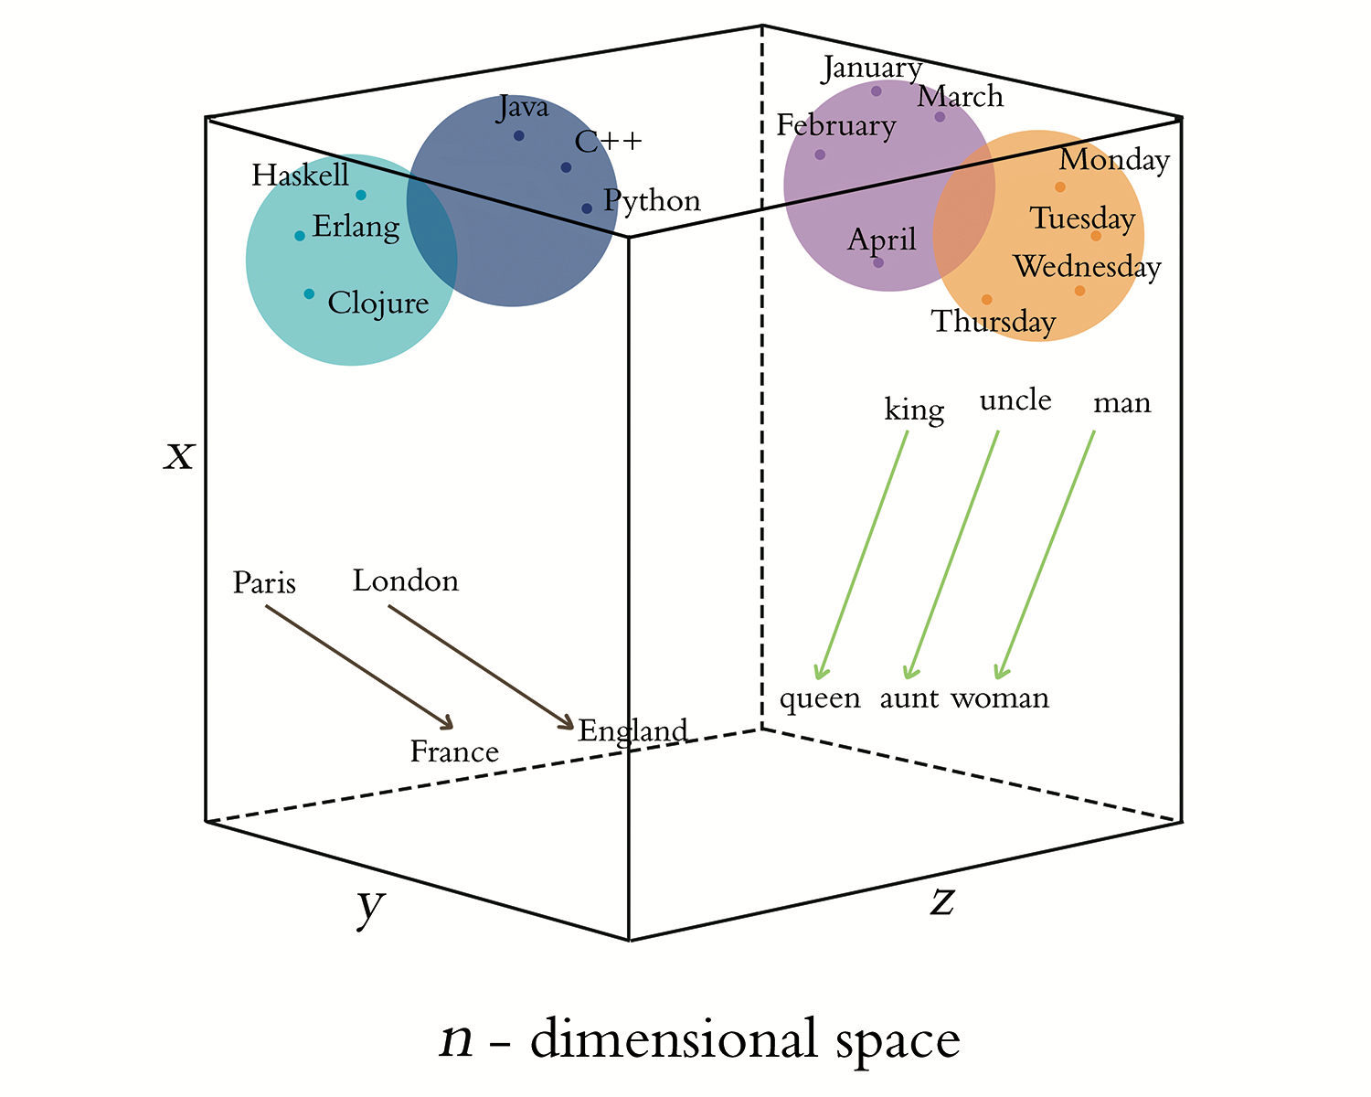

Slide 14
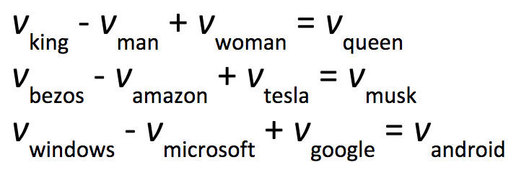

Slide 15
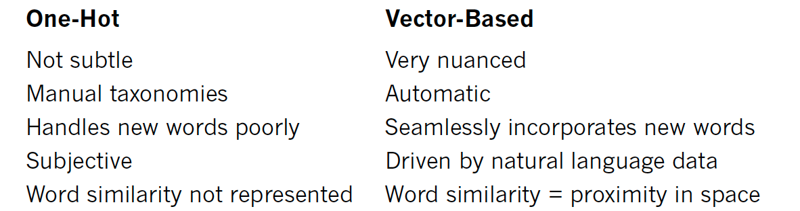
Word Representations

Slide 16
Elements of Natural Human Language

Slide 17
Chapter 11
Natural Language Processing

Slide 18
Preprocessing Natural Language Data
Tokenization: splitting document into list of discrete elements like words or sentences
To lowercase: She → she
Removing “stop words” (the, at)
Removing punctuation
Stemming (house → hous; housing → hous) OR Lemmatization (are → be; housing → house)
Handling n-grams: [new, york]→ [new_york]

Slide 19
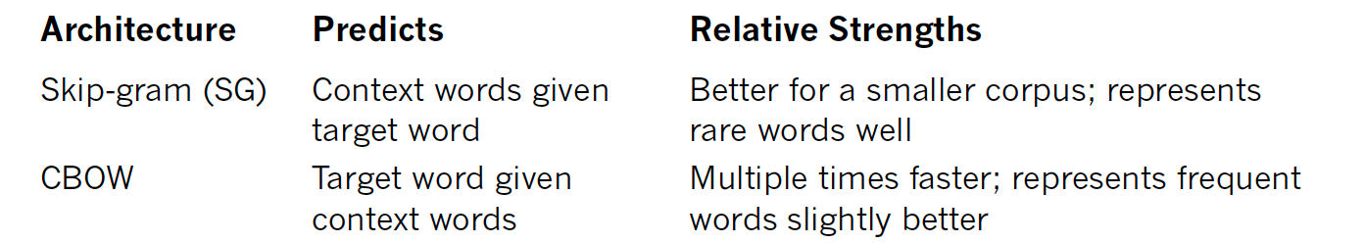
Comparison of word2vec Architectures
Notes:
Embed words from the corpus into word-vector space

Slide 20
Evaluating Word Vectors
Extrinsic
Assessing word vectors based on performance of downstream NLP application
Intrinsic
Evaluating word vectors on intermediate task
Do they respond well to word-vector arithmetic

Slide 22
Word Vectors in Deep Learning Models
Training word vectors as part of embedding layer
Backprop gives advantage that relevance of the words to the model’s purpose is also considered
Training independently on natural language data alone
Word2vec & GloVe
Using Pre-trained word vectors

Slide 23
Pre-Trained Word Vectors
word2vec: github.com/Kyubyong/wordvectors
GloVe: nlp.stanford.edu/projects/glove
fastText: fasttext.cc
François Chollet tutorial: bit.ly/preTrained

Slide 24
Evaluating Classification Models
Confusion Matrix
Matrix of TP, FP, FN, TN
ROC AUC
Calculated based on confusion matrix → blends TPR & FPR
Evaluates accuracy across multiple thresholds
> .5 is better than guessing; < .5 worse than guessing
See p. 217-222 for more details

Slide 25
Applied Deep Learning
Module 7:
Chapter 11
Time Series
Notes:
These are notes for the slide

Slide 26
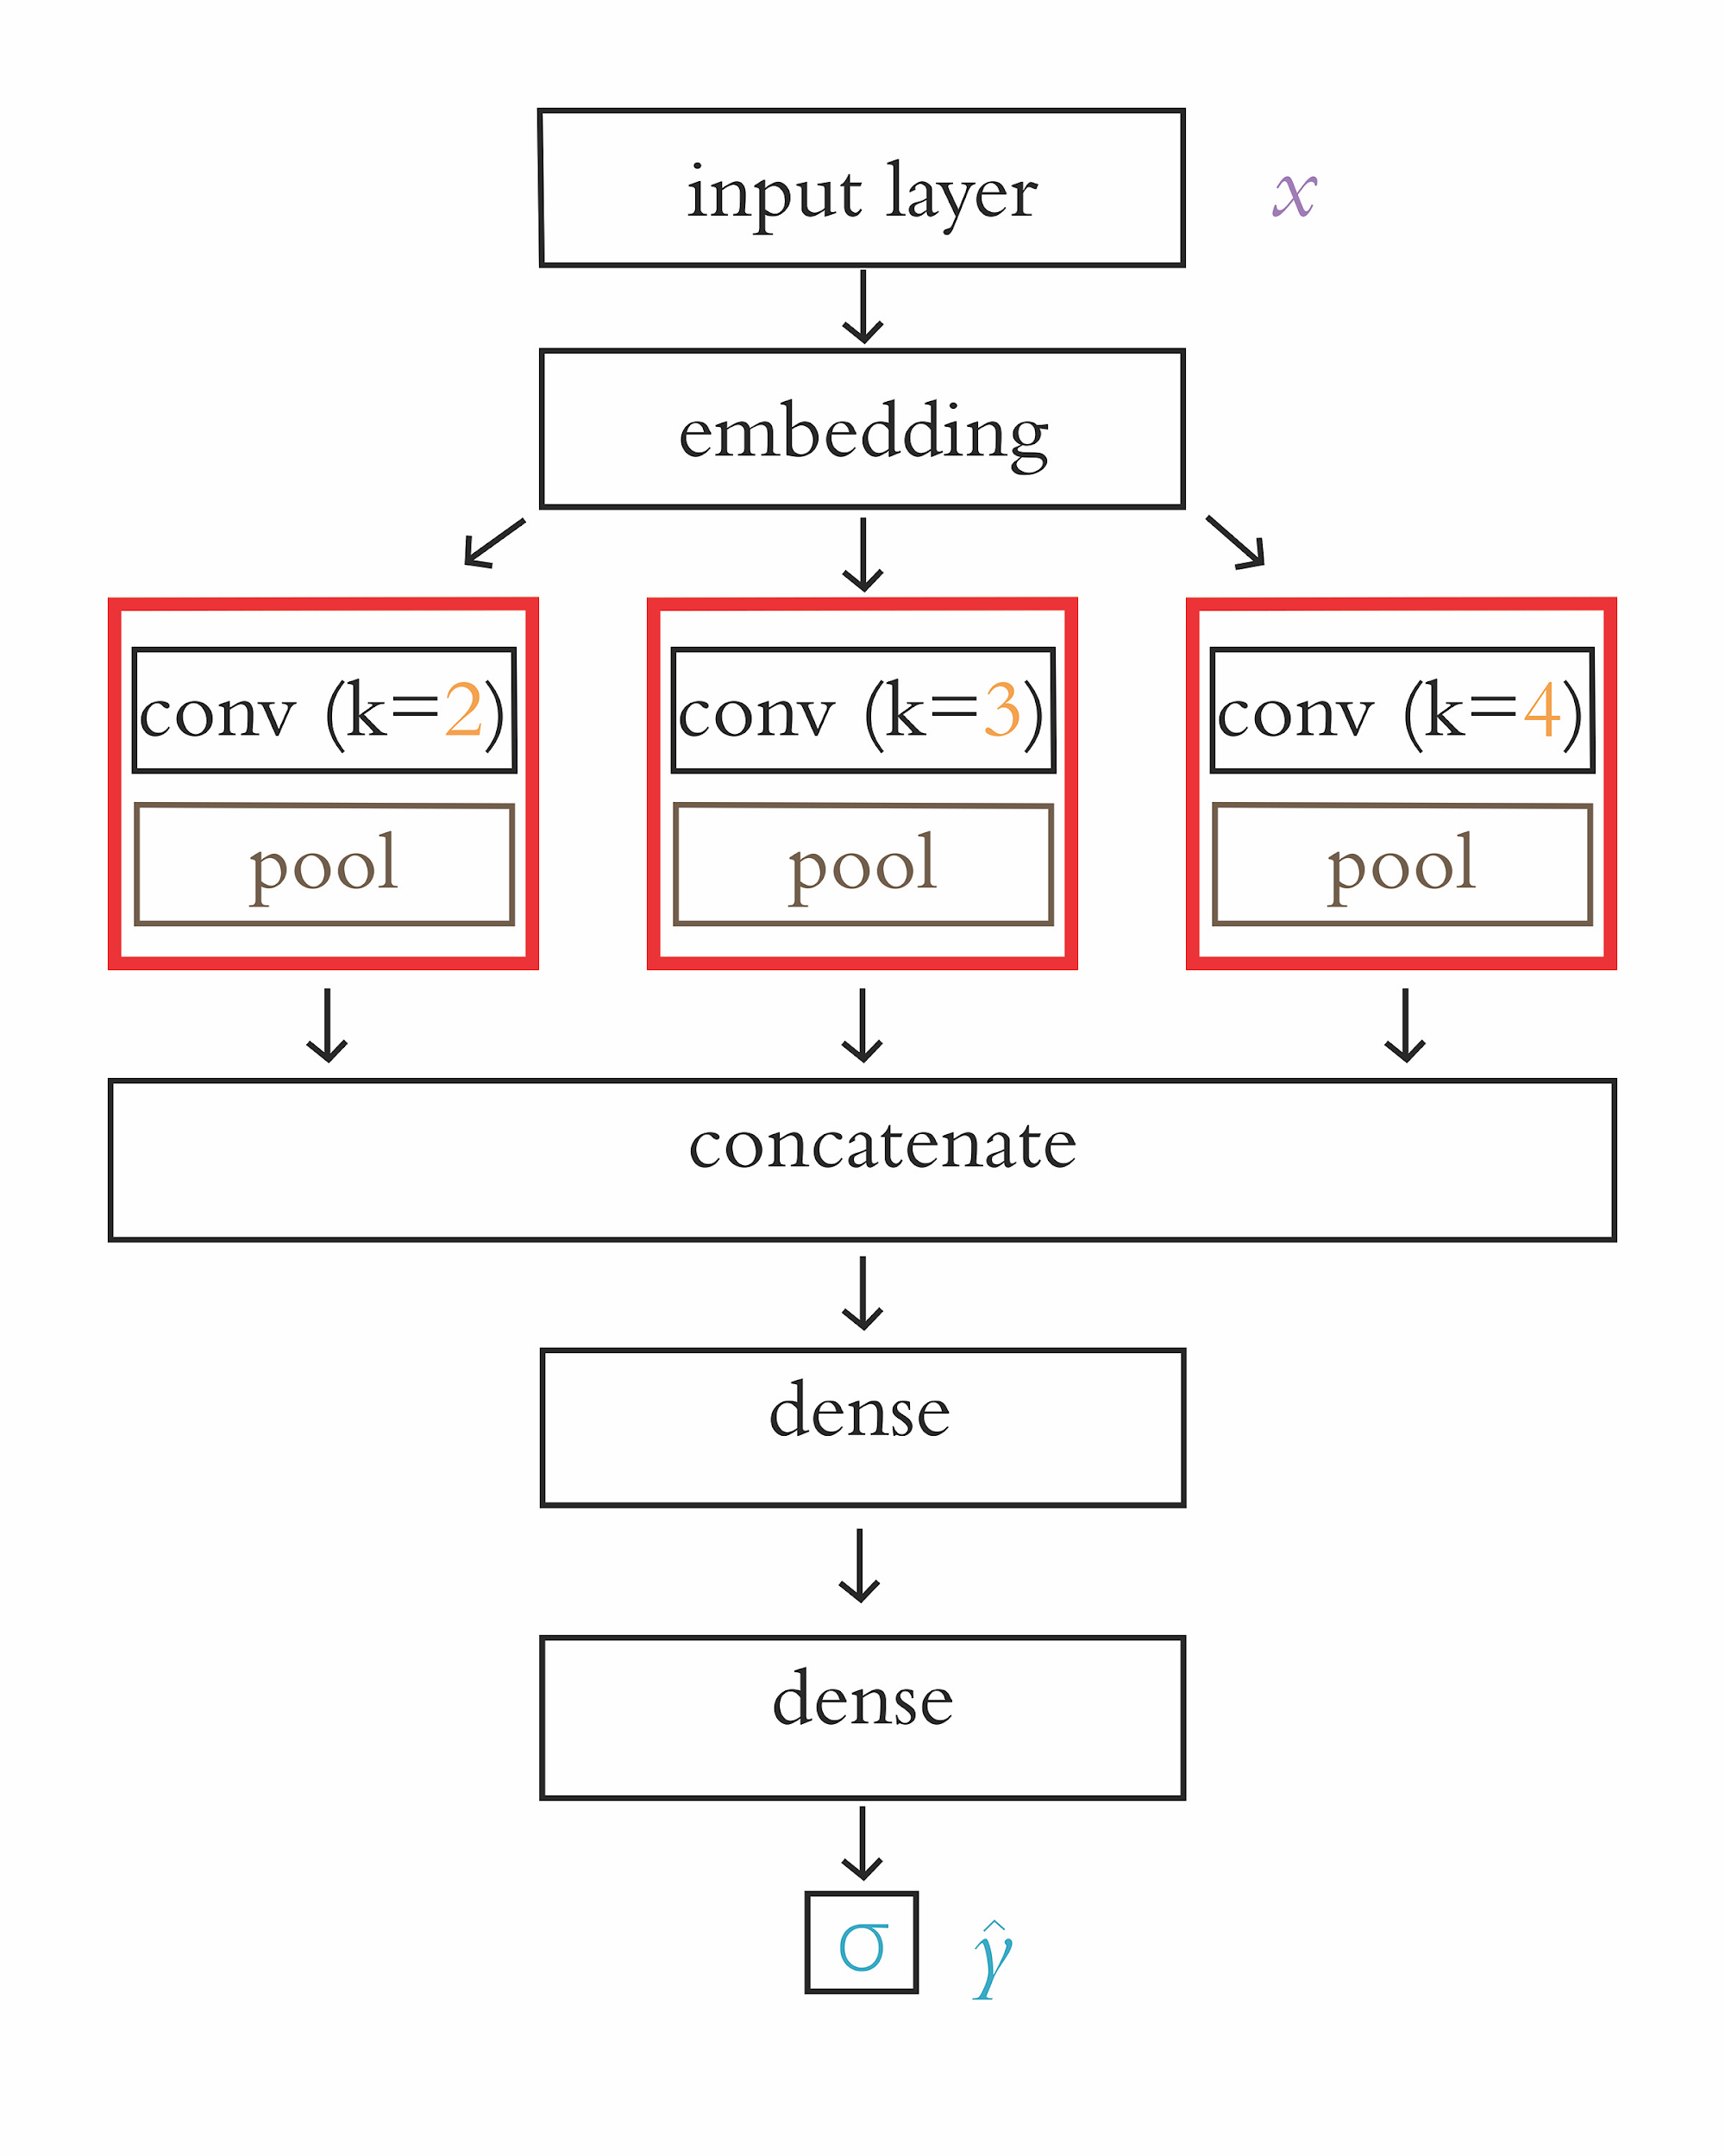
Chapter 11
Natural Language Processing

Slide 27
Recurrent Neural Networks
Designed for long sequences of data, as opposed to CNN that are designed for shorter sequences
Contain a loop that passes info between steps in network
There is a recurrent module for each input (word in sentence)
Computationally more complex than feedforward networks like Dense & CNN’s
Backprop occurs back toward input layer AND back over earlier timesteps
Gradient diminishes significantly after 10 timesteps (max_review_length)

Slide 28
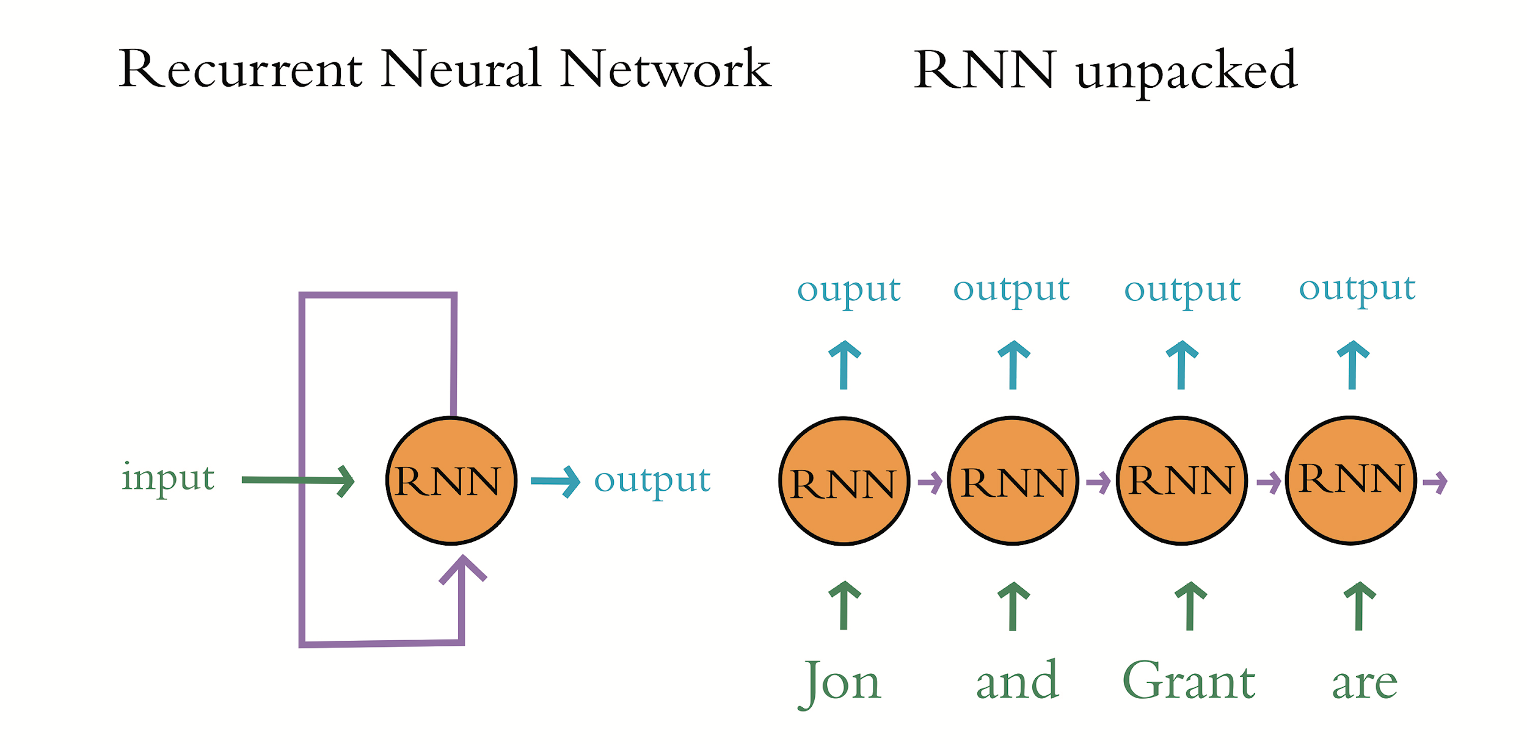

Slide 29
LSTM
More complex structure than simple RNN’s
Pass hidden state and cell state between timesteps
Contain 5 activation functions compared to 1 in simple RNN
Begin to overfit earlier than simple RNN’s

Slide 30
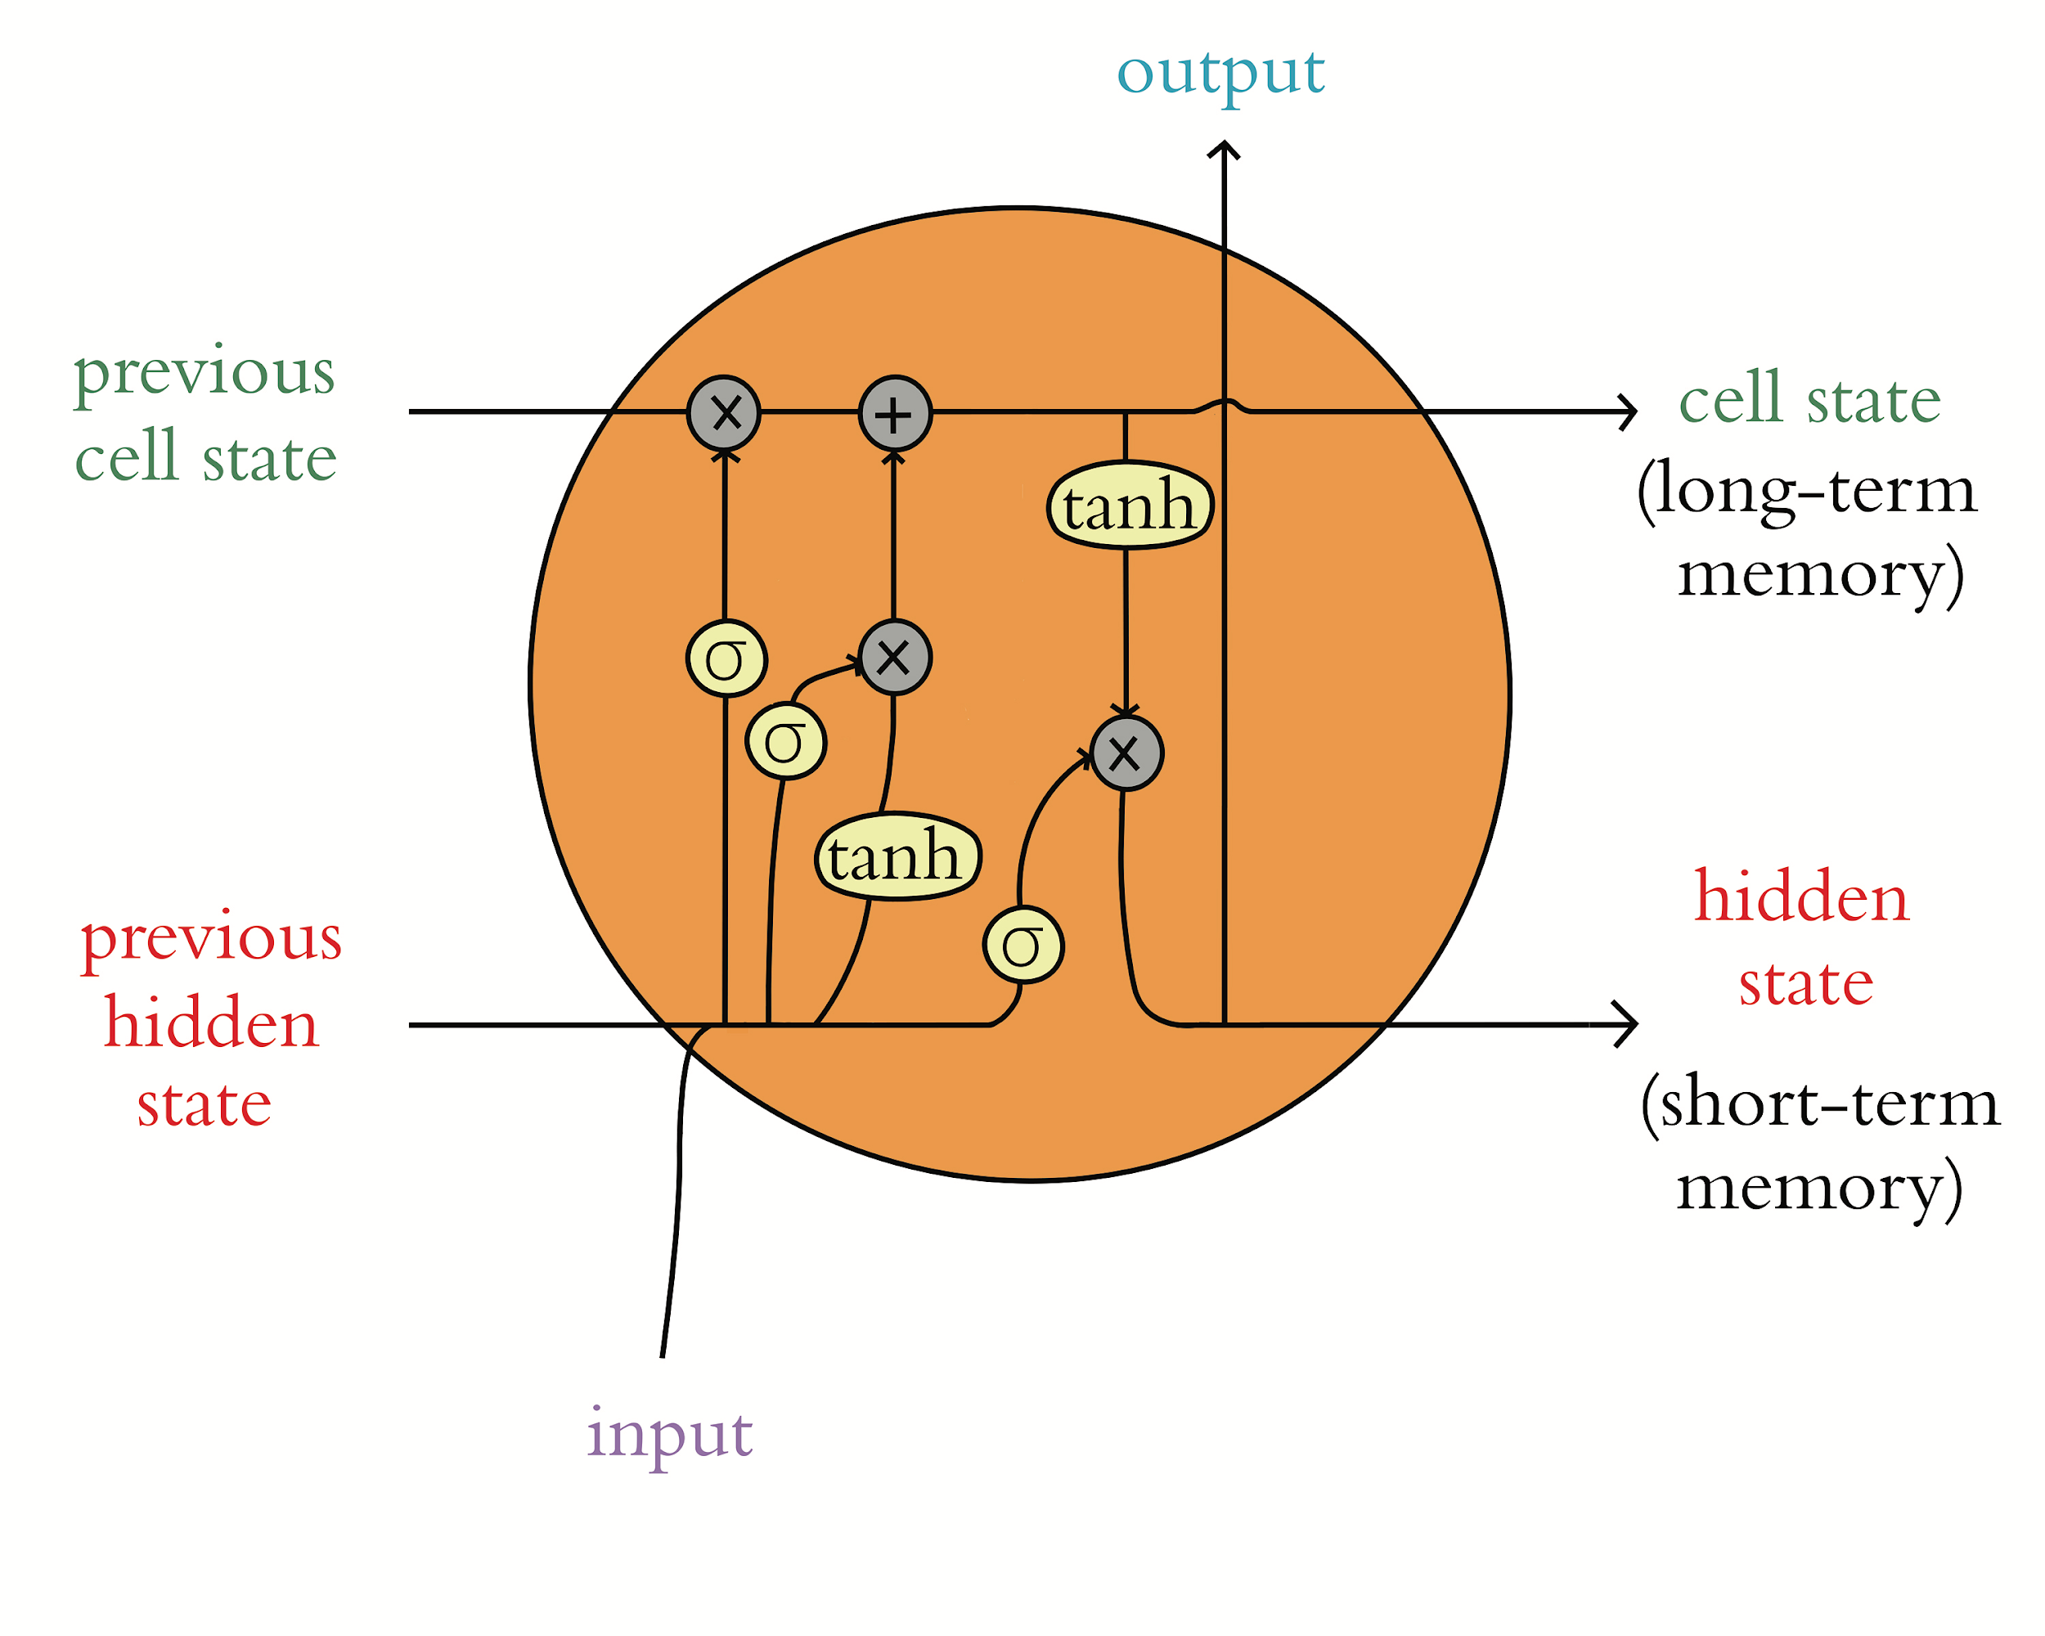

Slide 31
Bidirectional LSTM
Backprop backward AND forward over timesteps
Doubles computational complexity → but increase in accuracy generally worth it
Popular in NLP because can learn patterns before and after tokens
Wrap LSTM layer with Bidirectional wrapper

Slide 32
Stacked Recurrent Models
Recurrent layers pass along hidden state from each timestep
The final output of recurrent layer is FINAL hidden state
Need to return hidden state for EACH step in sequence in order to stack recurrent layers
Use return_sequences=True
Only need the final hidden state to pass along to non-recurrent layer (Dense, for example)

Slide 33
Prominent seq2seq Model Concepts
“seek-to-seek”: take in input sequence and generate output sequence
Neural machine translation (NMT): encoder processes input and decoder generates output sequence
Encoder & Decoder are RNN’s → passes along ‘context’, which is a bottleneck
Attention: created to overcome computational bottleneck of contex → pass the full sequence of hidden states to decoder

Slide 34
Models for Transfer Learning in NLP
ULMFiT: models fine-tuned on task-specific data
ELMo: looks at each word in sentence before assigning embedding
BERT: tuned to specific NLP tasks → great results requiring less training time and fewer data

Slide 35
A Non-Sequential Model Architecture

Slide 36
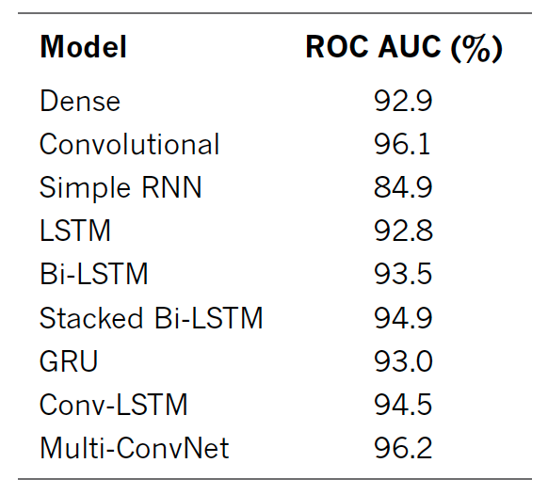
Performance of our Sentiment Classifiers

Slide 37
Applied Deep Learning
Module 8:
Chapter 3
Chapter 12
Notes:
These are notes for the slide

Slide 38
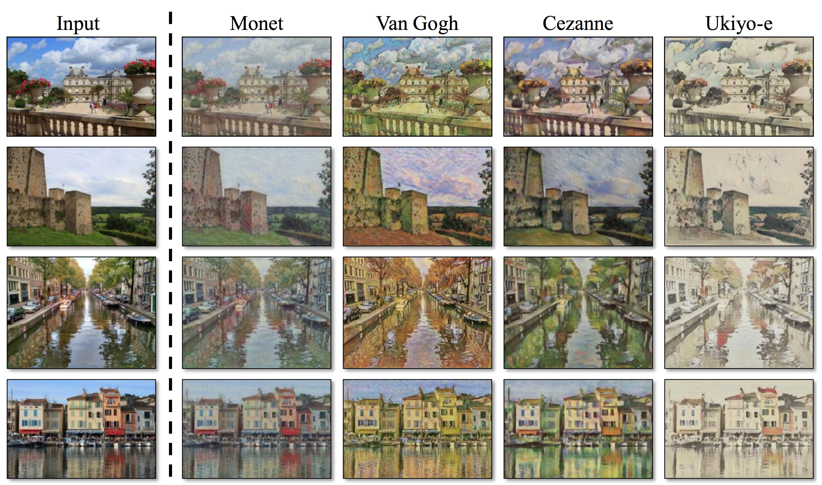
Chapter 3
Machine Art

Slide 39
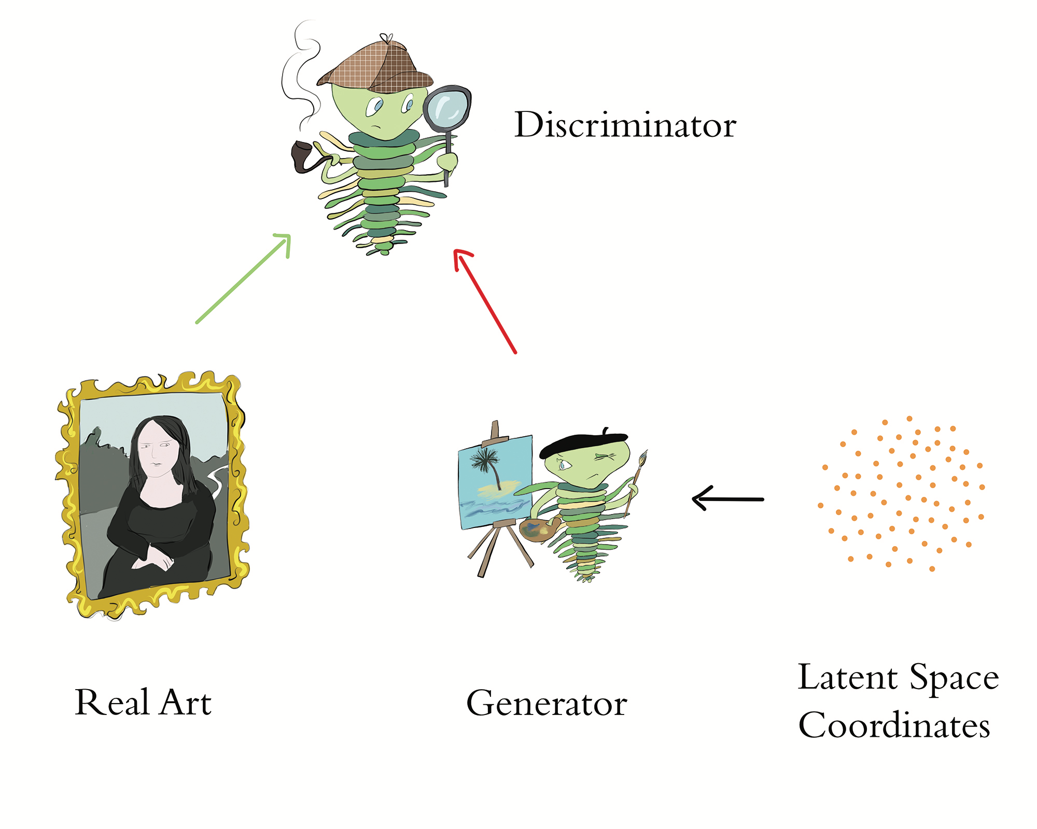

Slide 40
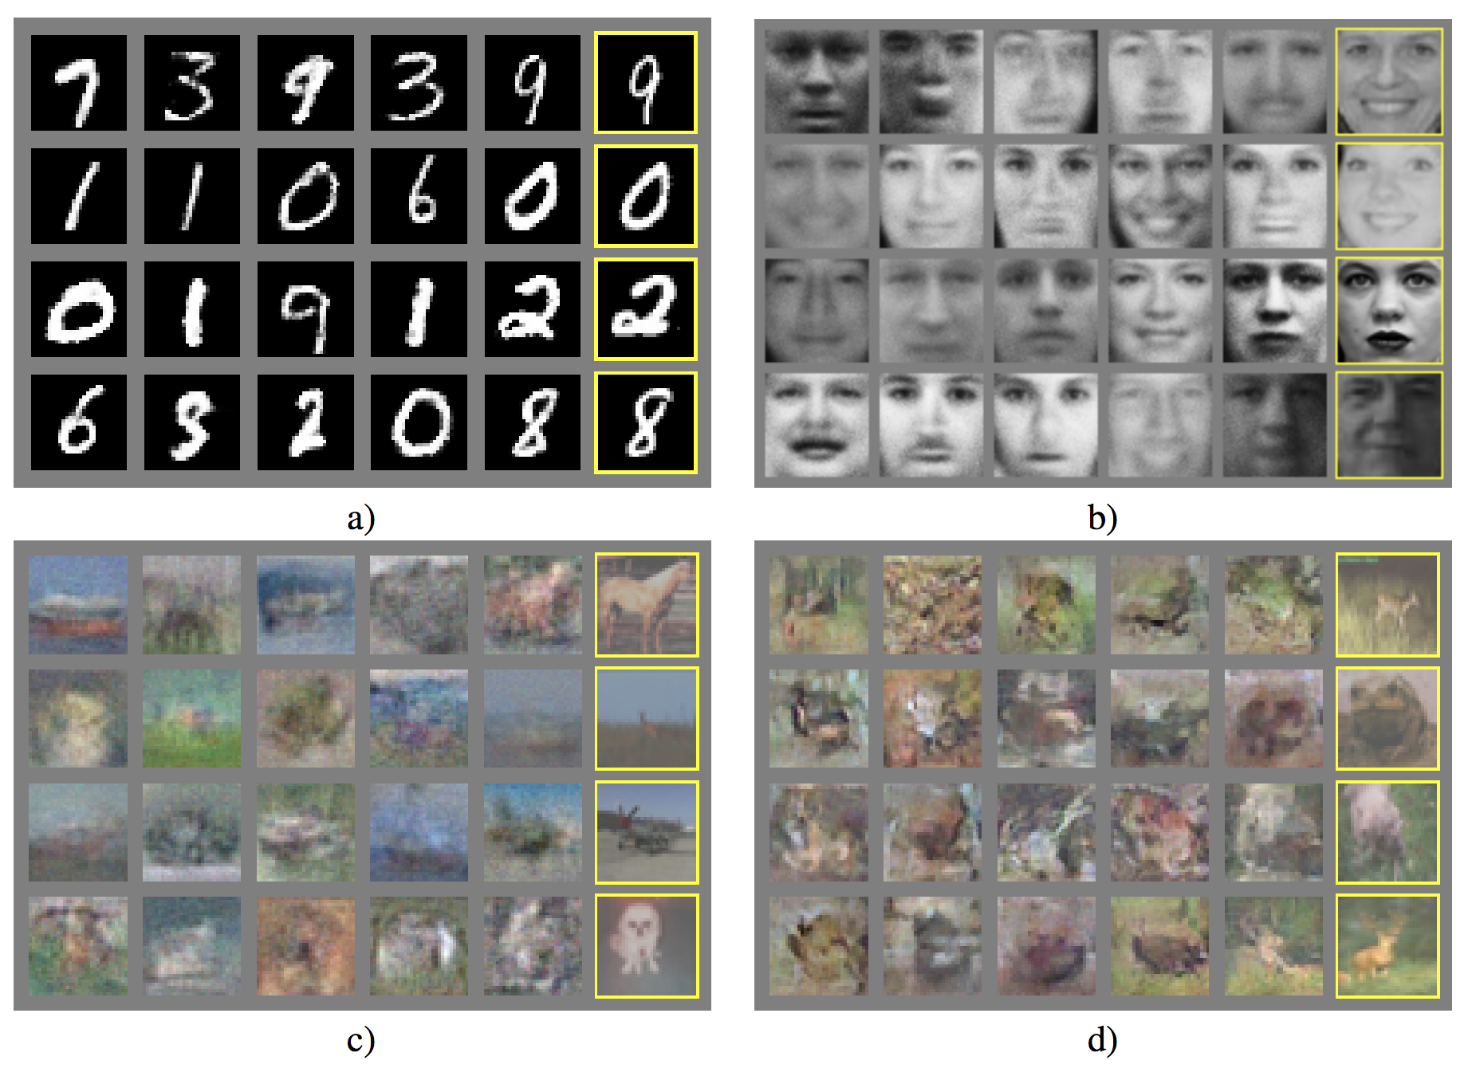
GANs (Goodfellow et al., 2014)
arXiv: 1406.2661

Slide 41
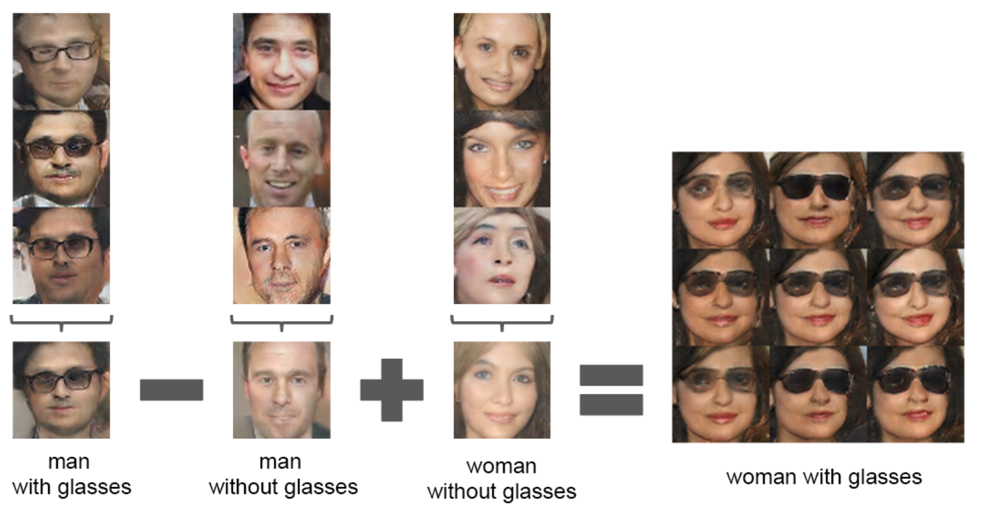
DCGANs (Radford et al., 2016)
arXiv: 1511.06434

Slide 42
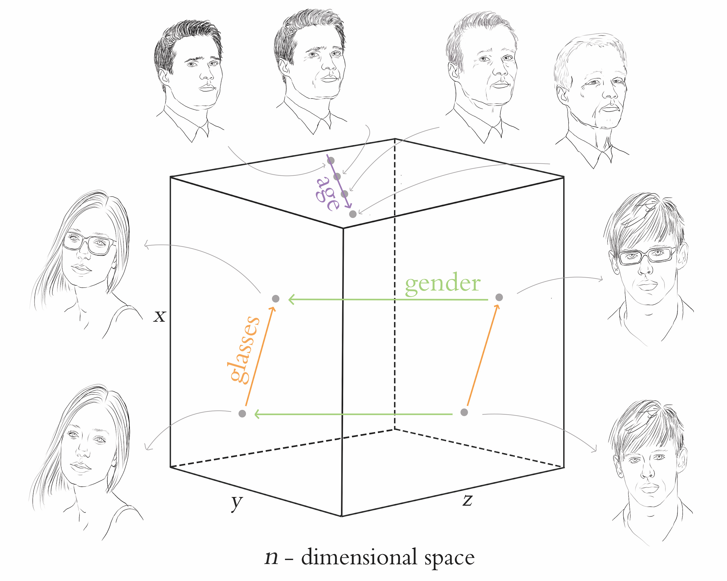

Slide 43
CycleGAN (Zhu et al., 2017)
bit.ly/cycleGAN
arXiv: 1703.10593

Slide 44
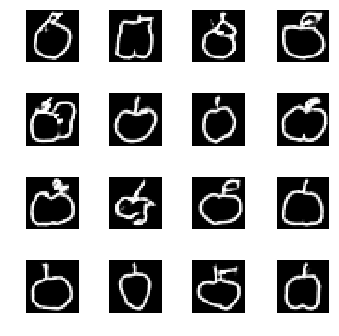

Slide 45
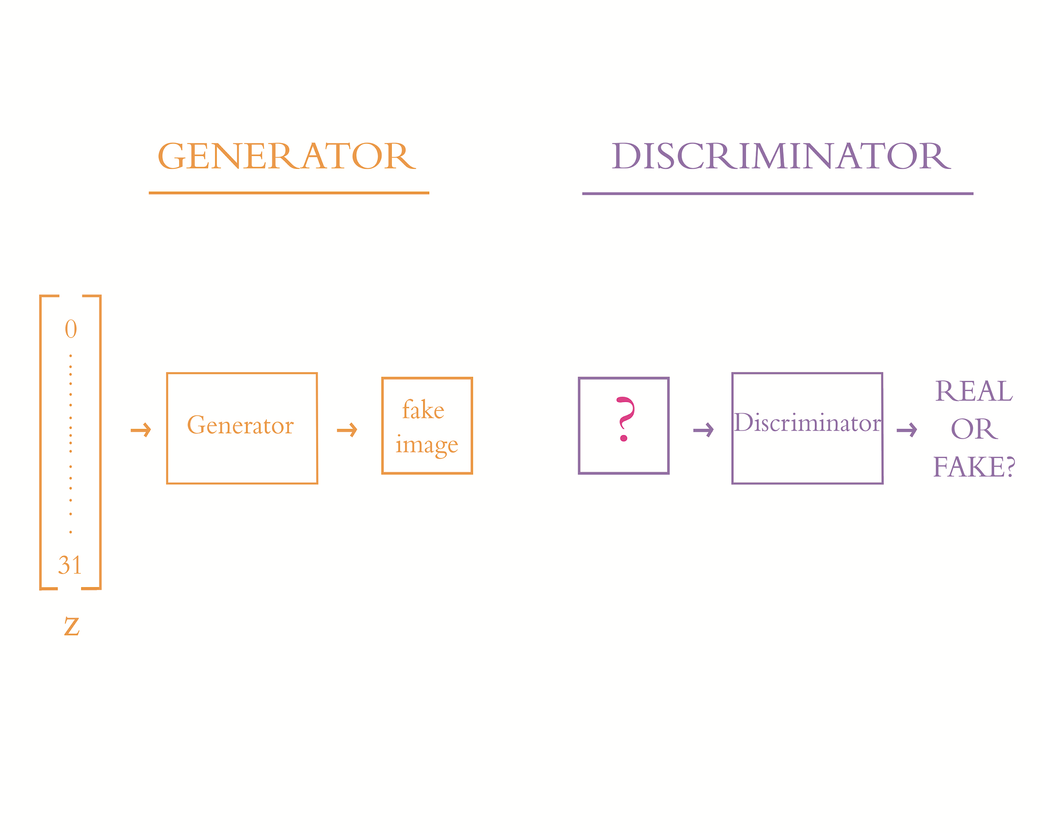
Chapter 12
Generative Adversarial Networks

Slide 48
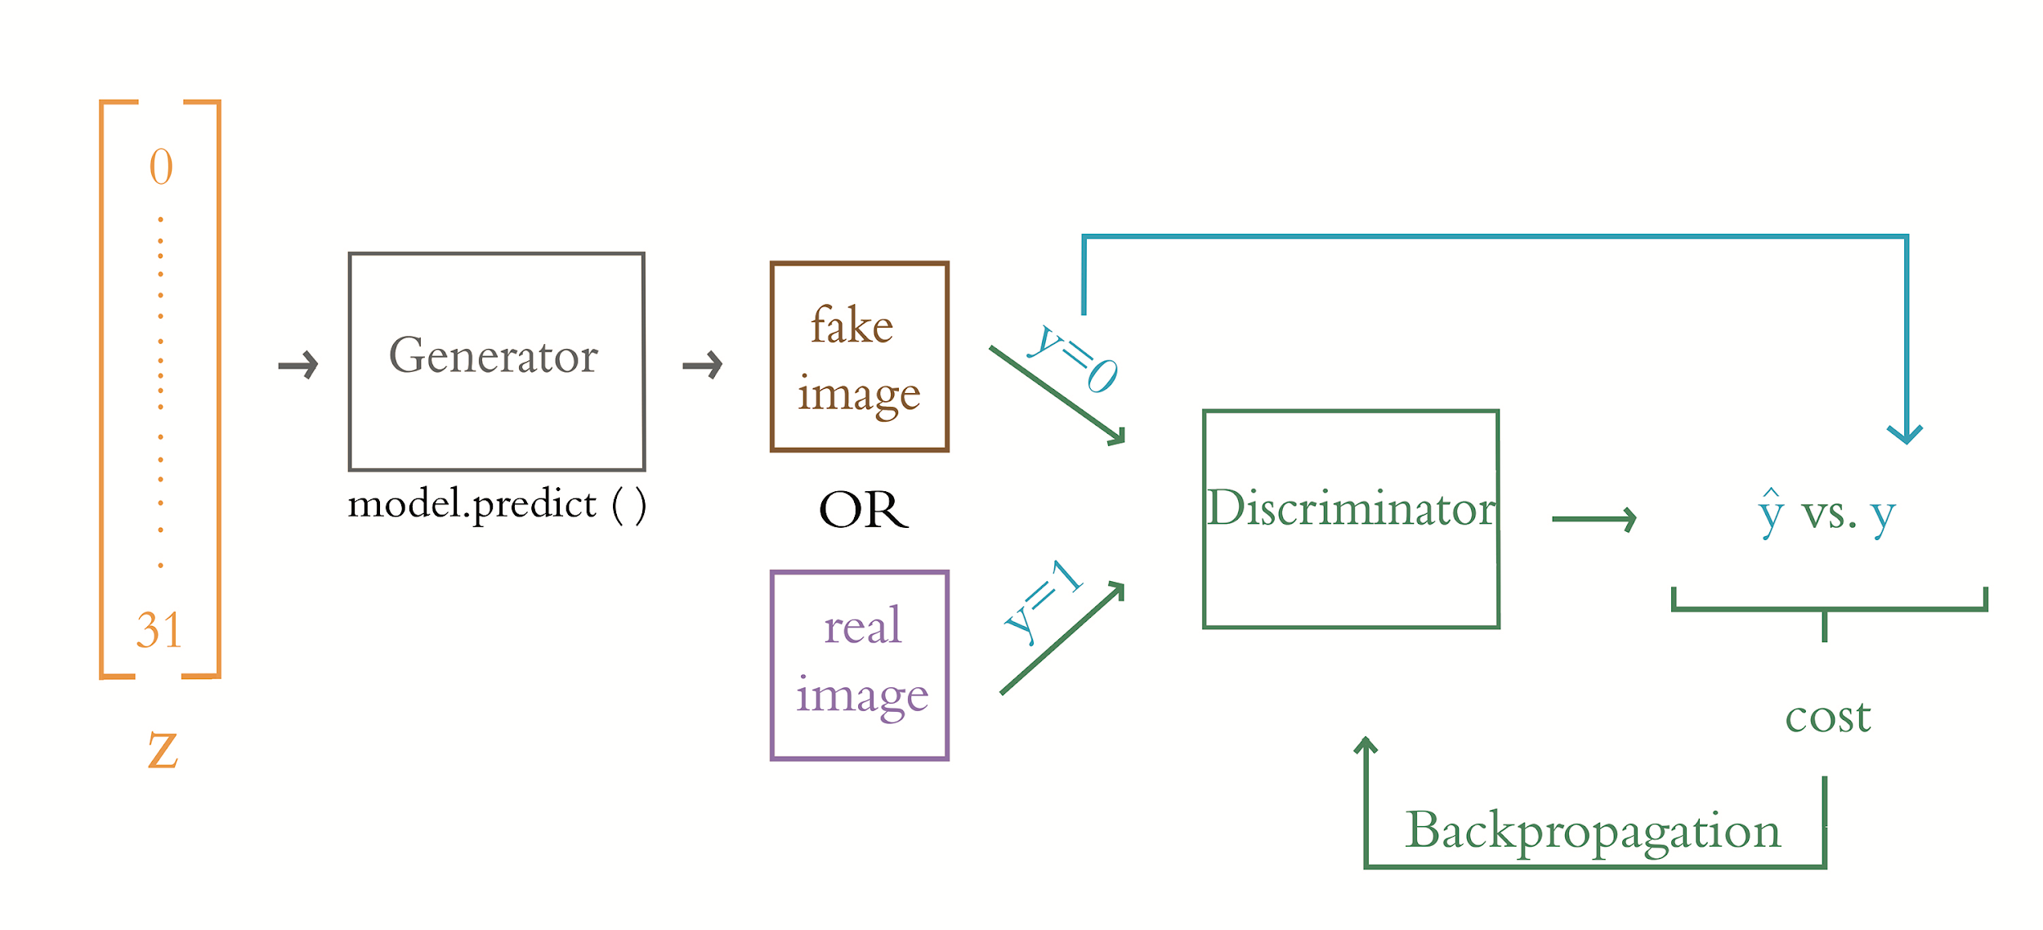
Training the Discriminator

Slide 49
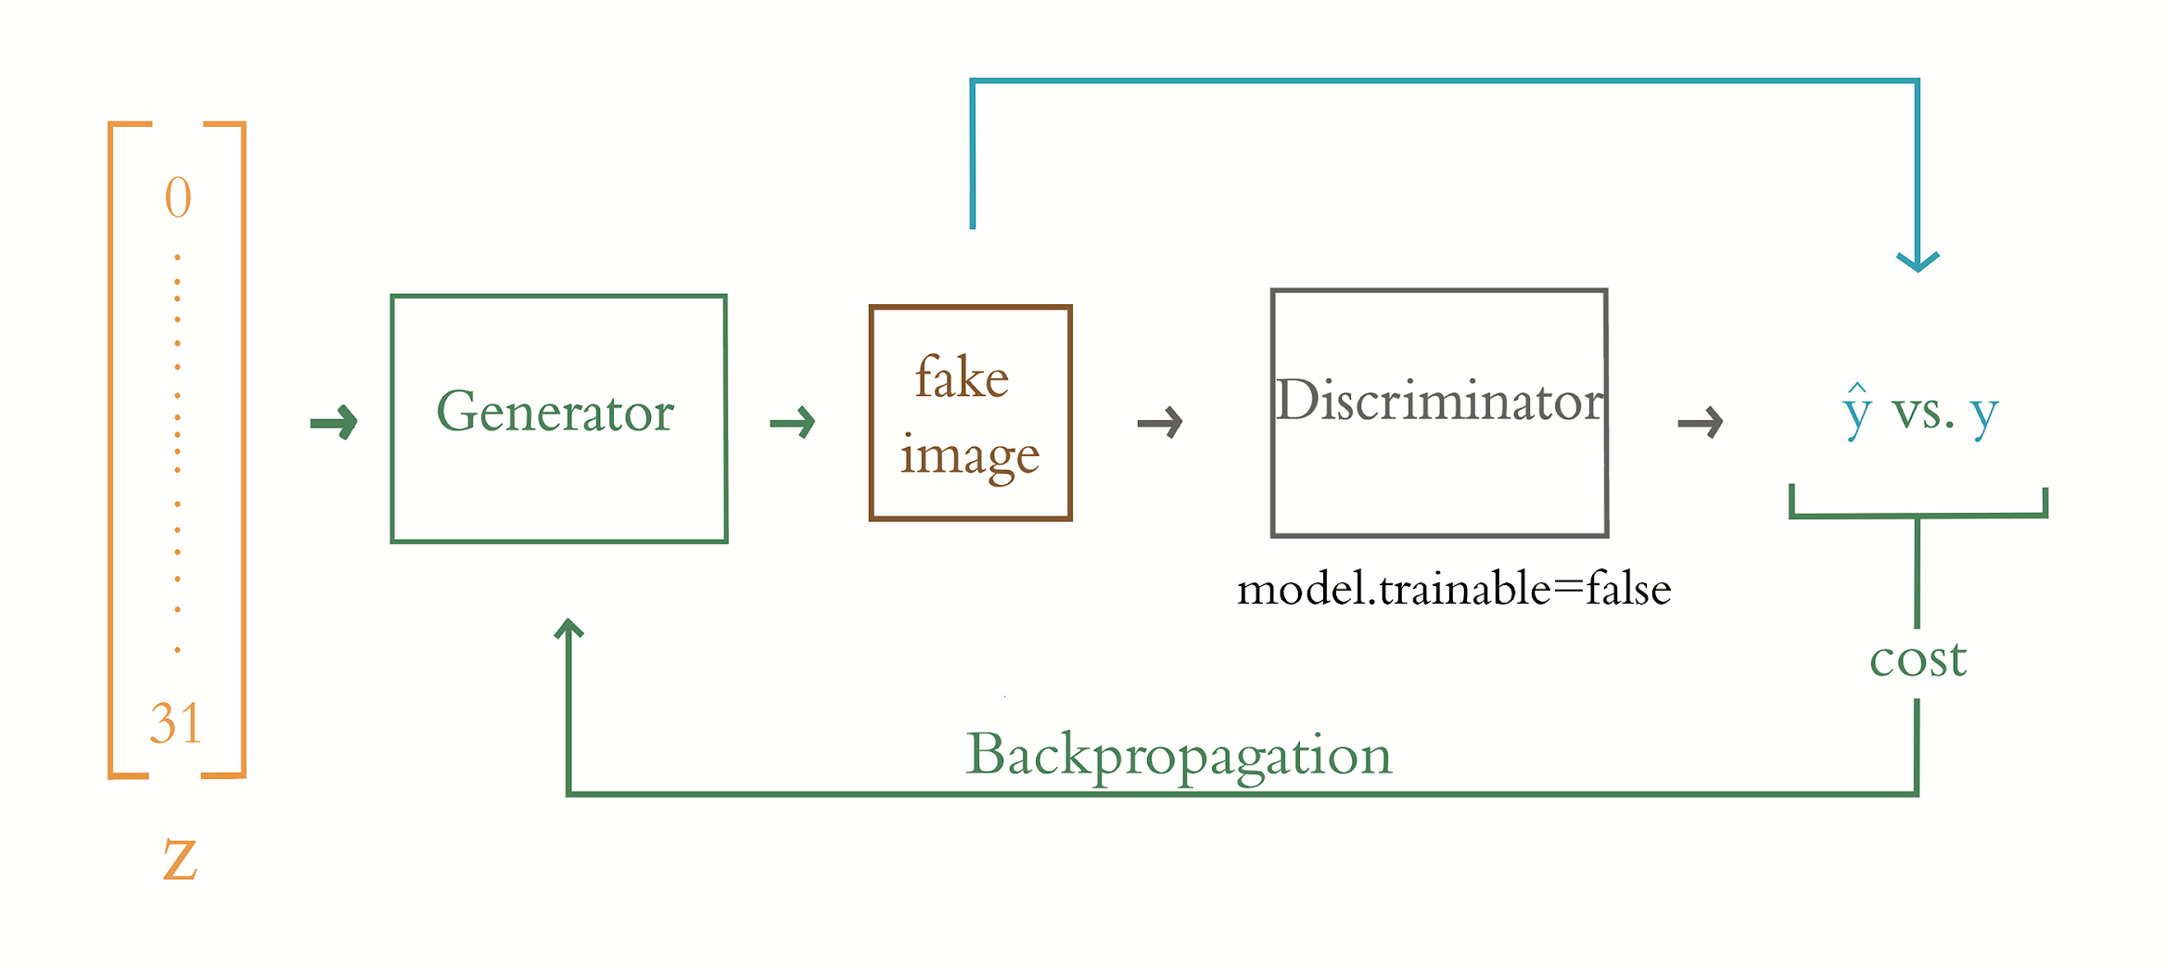
Training the Generator

Slide 50
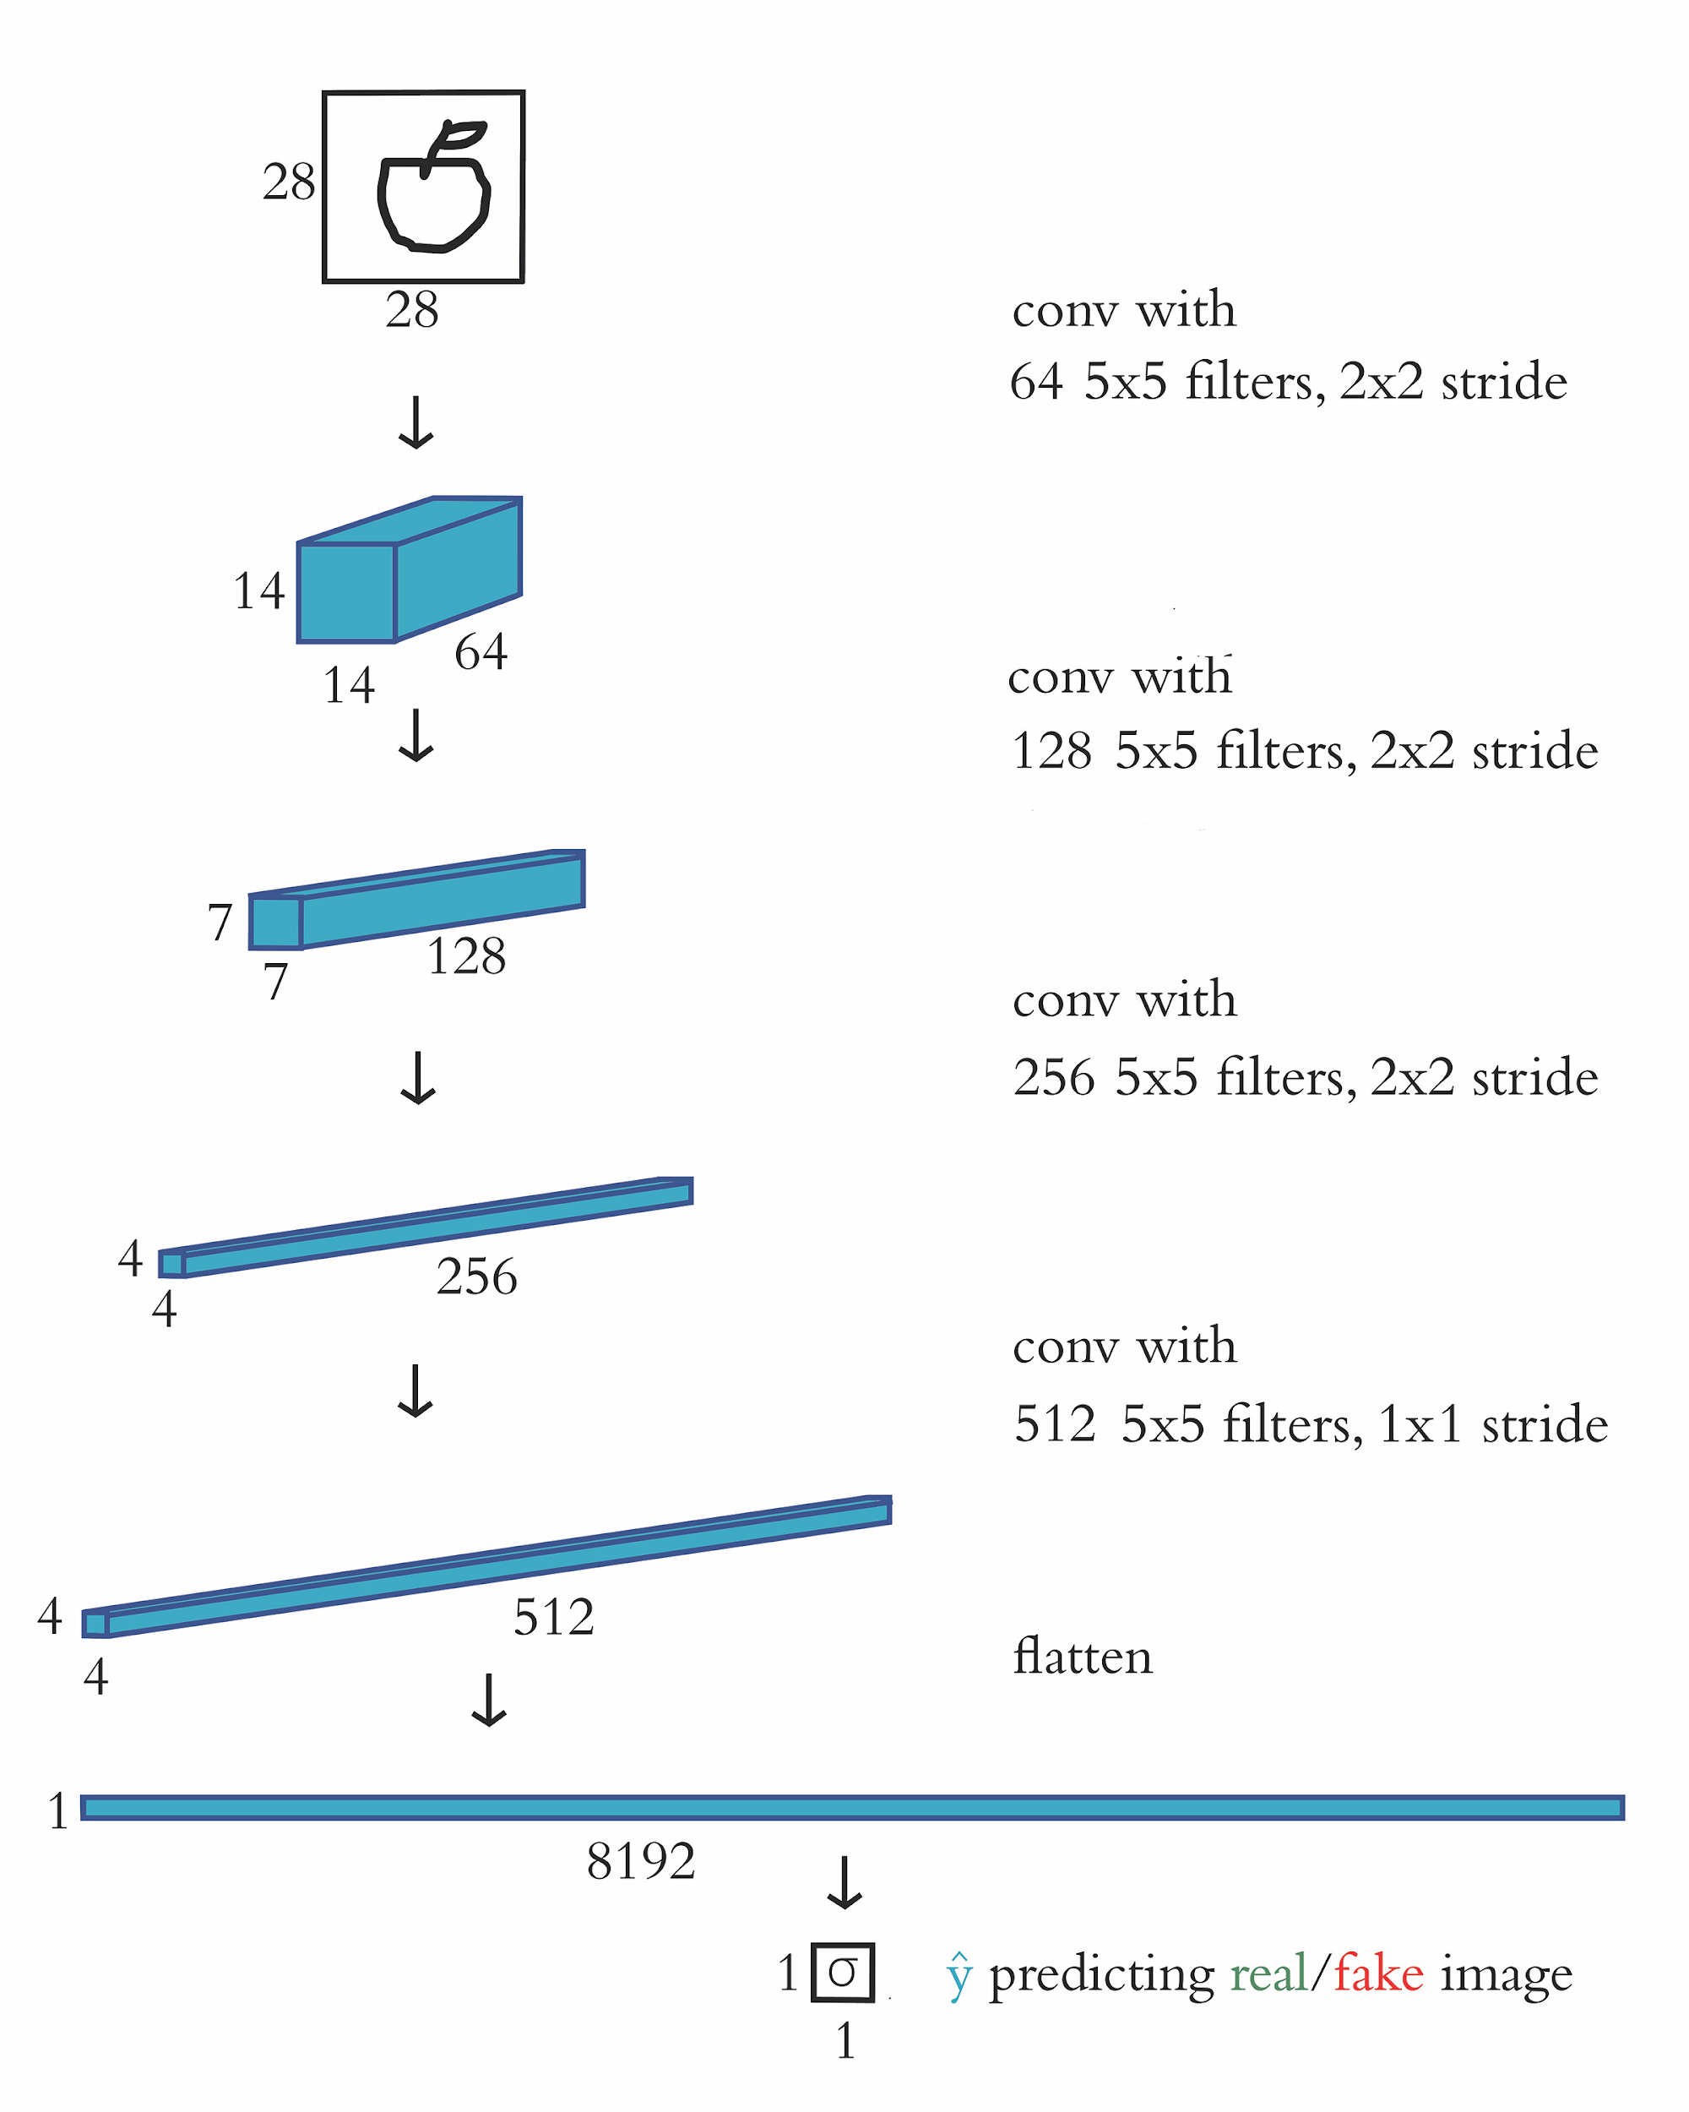

Slide 51
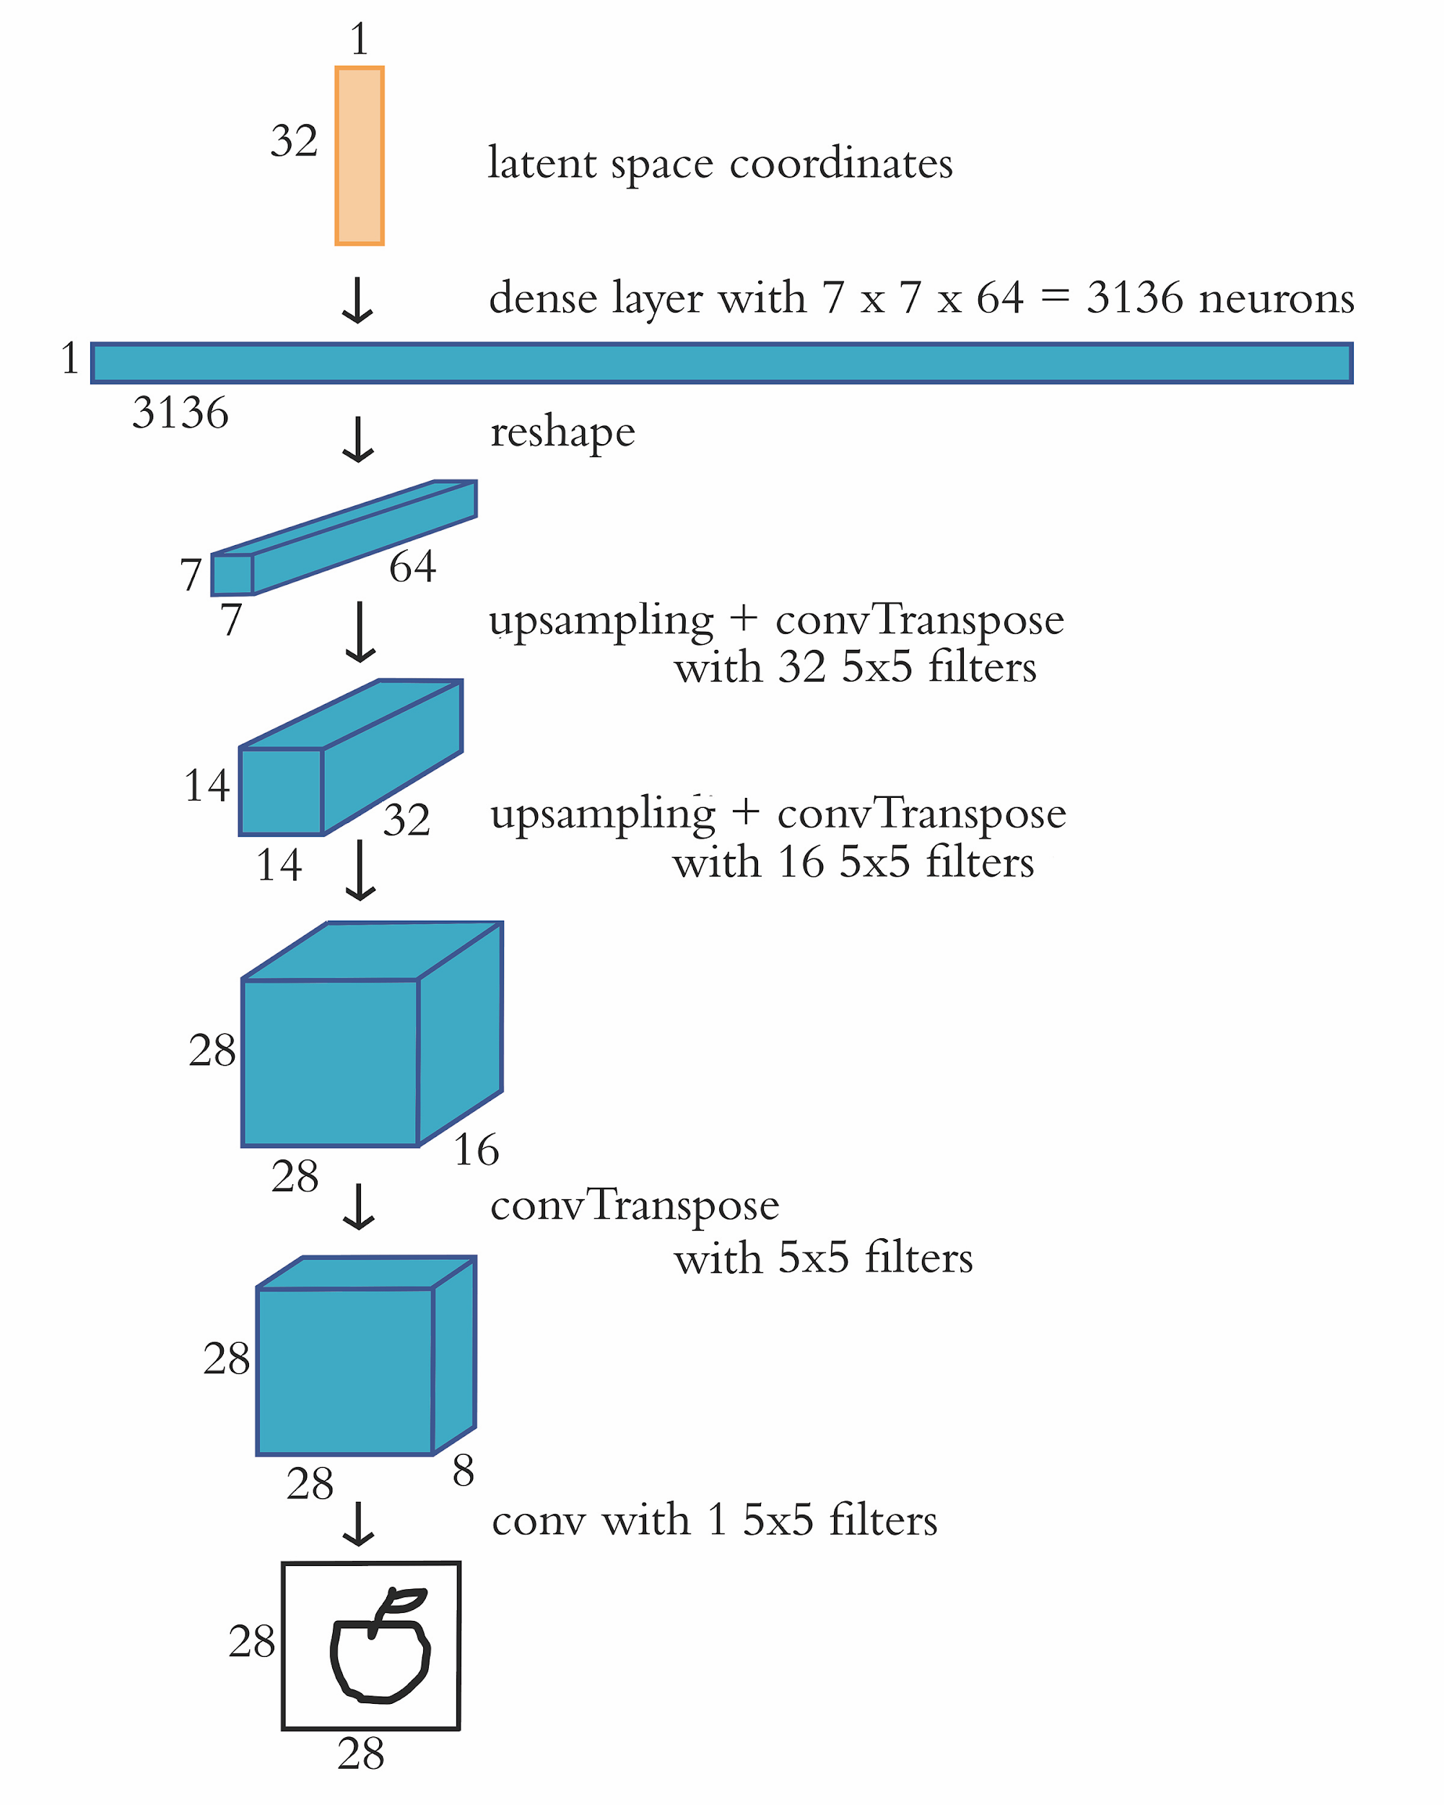

Slide 52
Training the Discriminator

Slide 53
Training the Generator

Slide 54
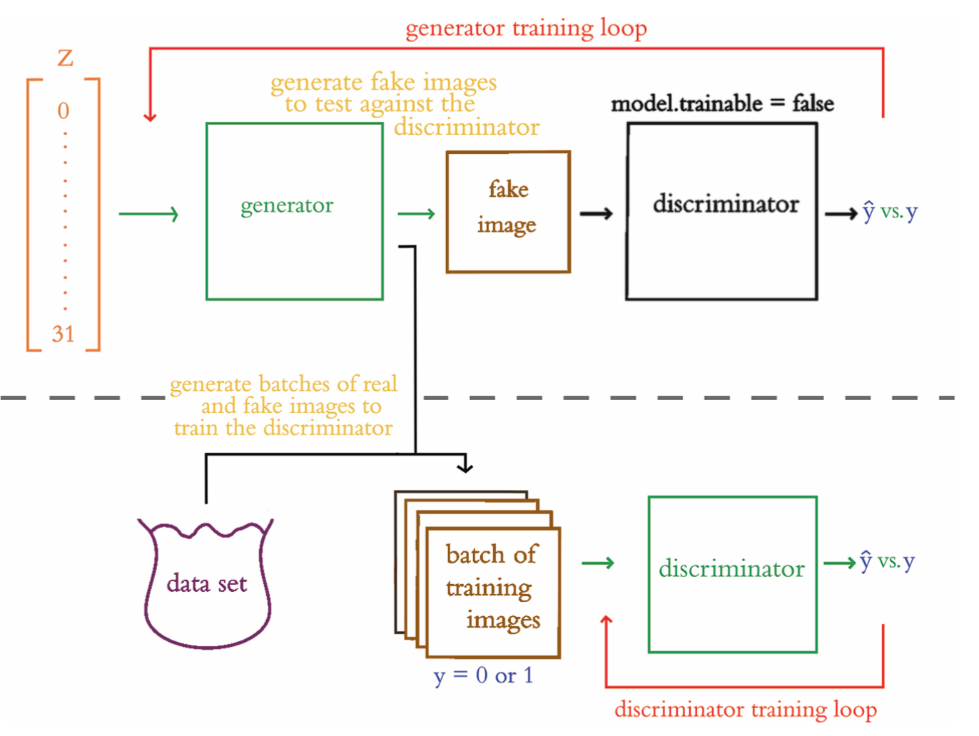

Slide 55
Categories of Machine Learning Problems
Supervised Learning
Unsupervised Learning
Reinforcement Learning

Slide 56
Supervised Learning
Have x and y
Goal: learn function that uses x to approximate y
Examples:
classification
handwritten digits
movie-review sentiment
regression
sales of a product
future value of an asset (e.g., a home)

Slide 57
Unsupervised Learning
Have x only -- no y labels available
Goal: learn hidden, underlying structure of data x
Examples:
clustering by topic
word vectors
GANs

Slide 58
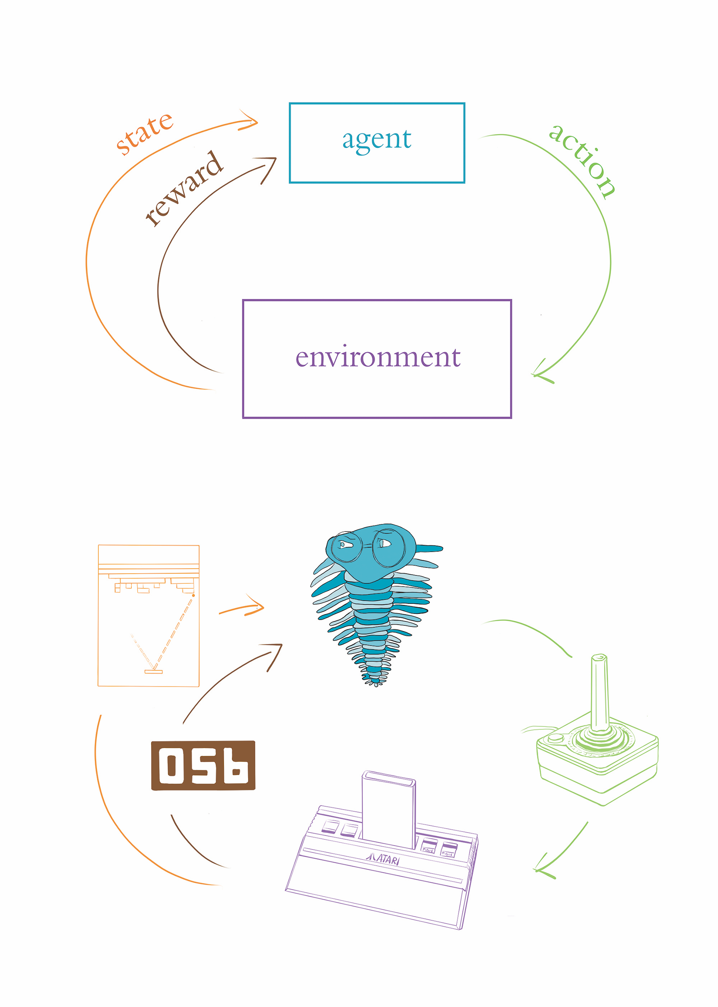
Reinforcement Learning

Slide 59
Artificial Intelligence
Machine Learning
Representation Learning
ANNs / Deep Learning
DL for
NLP
RNNs
NLP
LSTMs
Machine
Vision
CNNs
GANs
Reinforcement
Learning

Slide 60
Artificial Intelligence
Machine Learning
Representation Learning
ANNs / Deep Learning
DL for
NLP
RNNs
NLP
LSTMs
Machine
Vision
CNNs
Deep
RL
GANs
Reinforcement
Learning

Slide 61
Deep Reinforcement Learning
Reinforcement learning utilizing Deep ANNs
Learn actions to take in an environment for high probability of positive reward
Prosperous relationship between Deep & Reinforcement learning
Deep networks excel at processing complex sensory input
Reinforcement algorithms excel at selecting best action from vast scope of possibilities

Slide 62
Factors Behind the Deep Learning Tsunami
Data: exponentially larger datasets from very rich, simulated environments
Compute: parallel processing across many GPUs efficiently builds models from extremely large datasets
Theoretical Advances: research ecosystem from academia and industry creating quickly developed body of new ideas

Slide 63
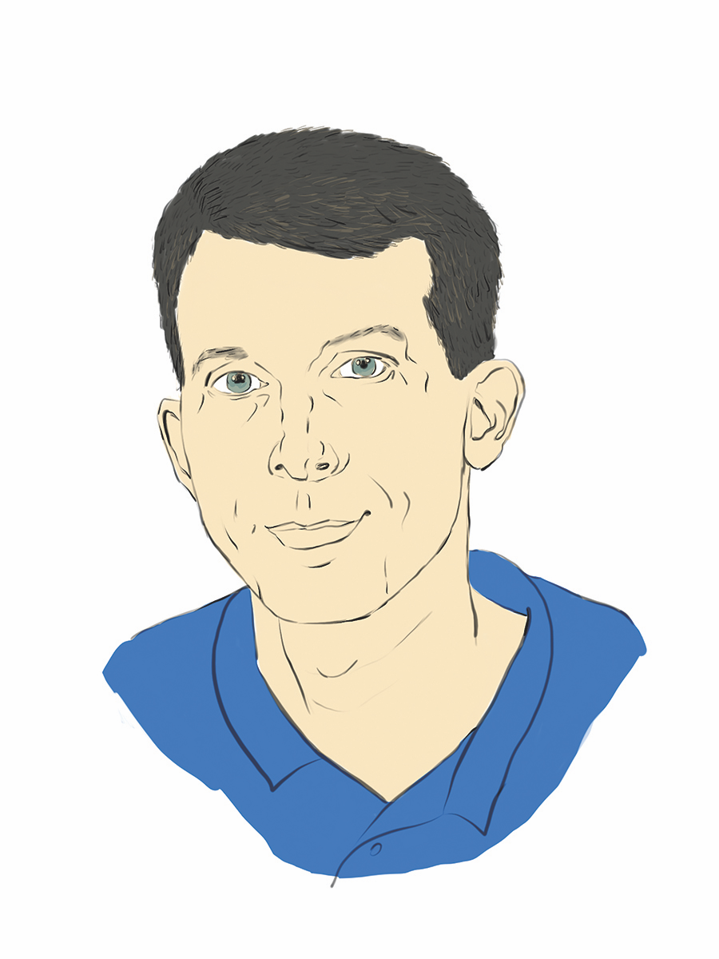
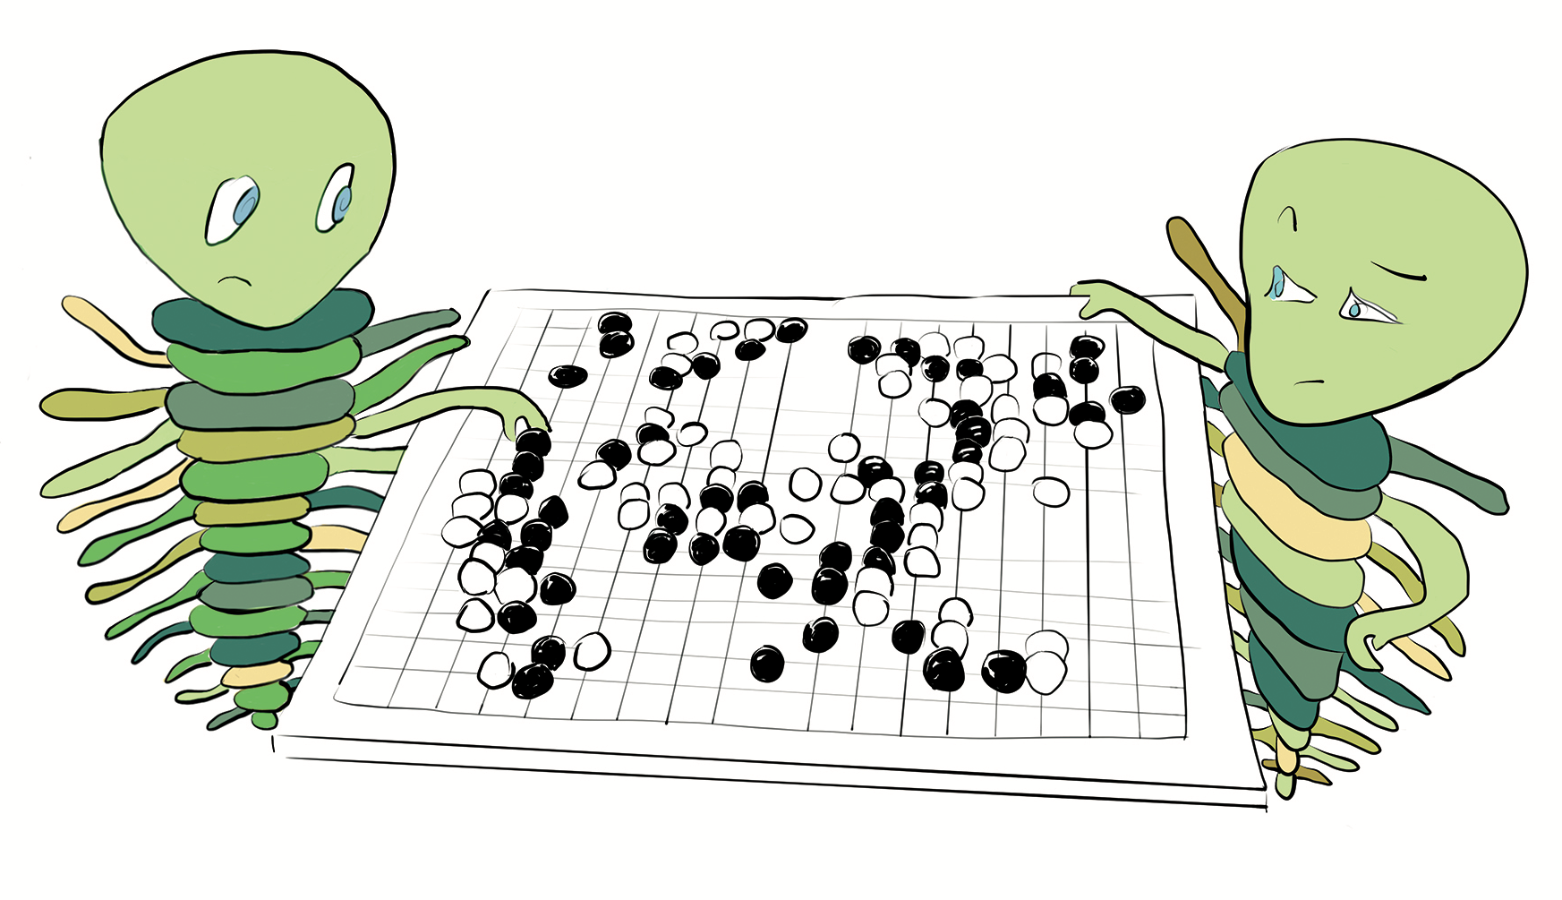
AlphaGo (Silver et al., 2016)

Slide 64
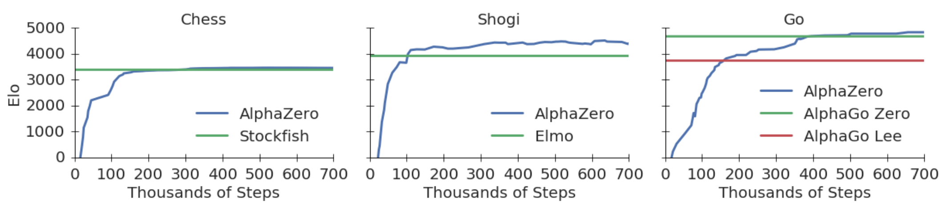
AlphaZero (Silver et al., 2017b)
arXiv: 1712.01815

Slide 65
Real-World Applications of Deep RL
Autonomous vehicles
Algorithmic trading strategies
Robotics

Slide 66
Popular Deep RL Environments
Software emulation of environments is crucial to train RL models
Create environments for agents to play and explore
Three popular software emulation environments:
OpenAI Gym: github.com/openai/gym
DeepMind Lab: github.com/deepmind/lab
Unity: github.com/Unity-Technologies/ml-agents
...or create your own with PyGame Learning Environment

Slide 67
Categories of Artificial Intelligence
ANI: Narrow – machine expertise at specific tasks
Visual recognition
NLP translation
AGI: General – single algorithm that performs well at all ANI tasks
Speculation will be achieved in 2040
ASI: Super – algorithm more advanced than intellectual capabilities of a human
Median estimate is 2060

Slide 68
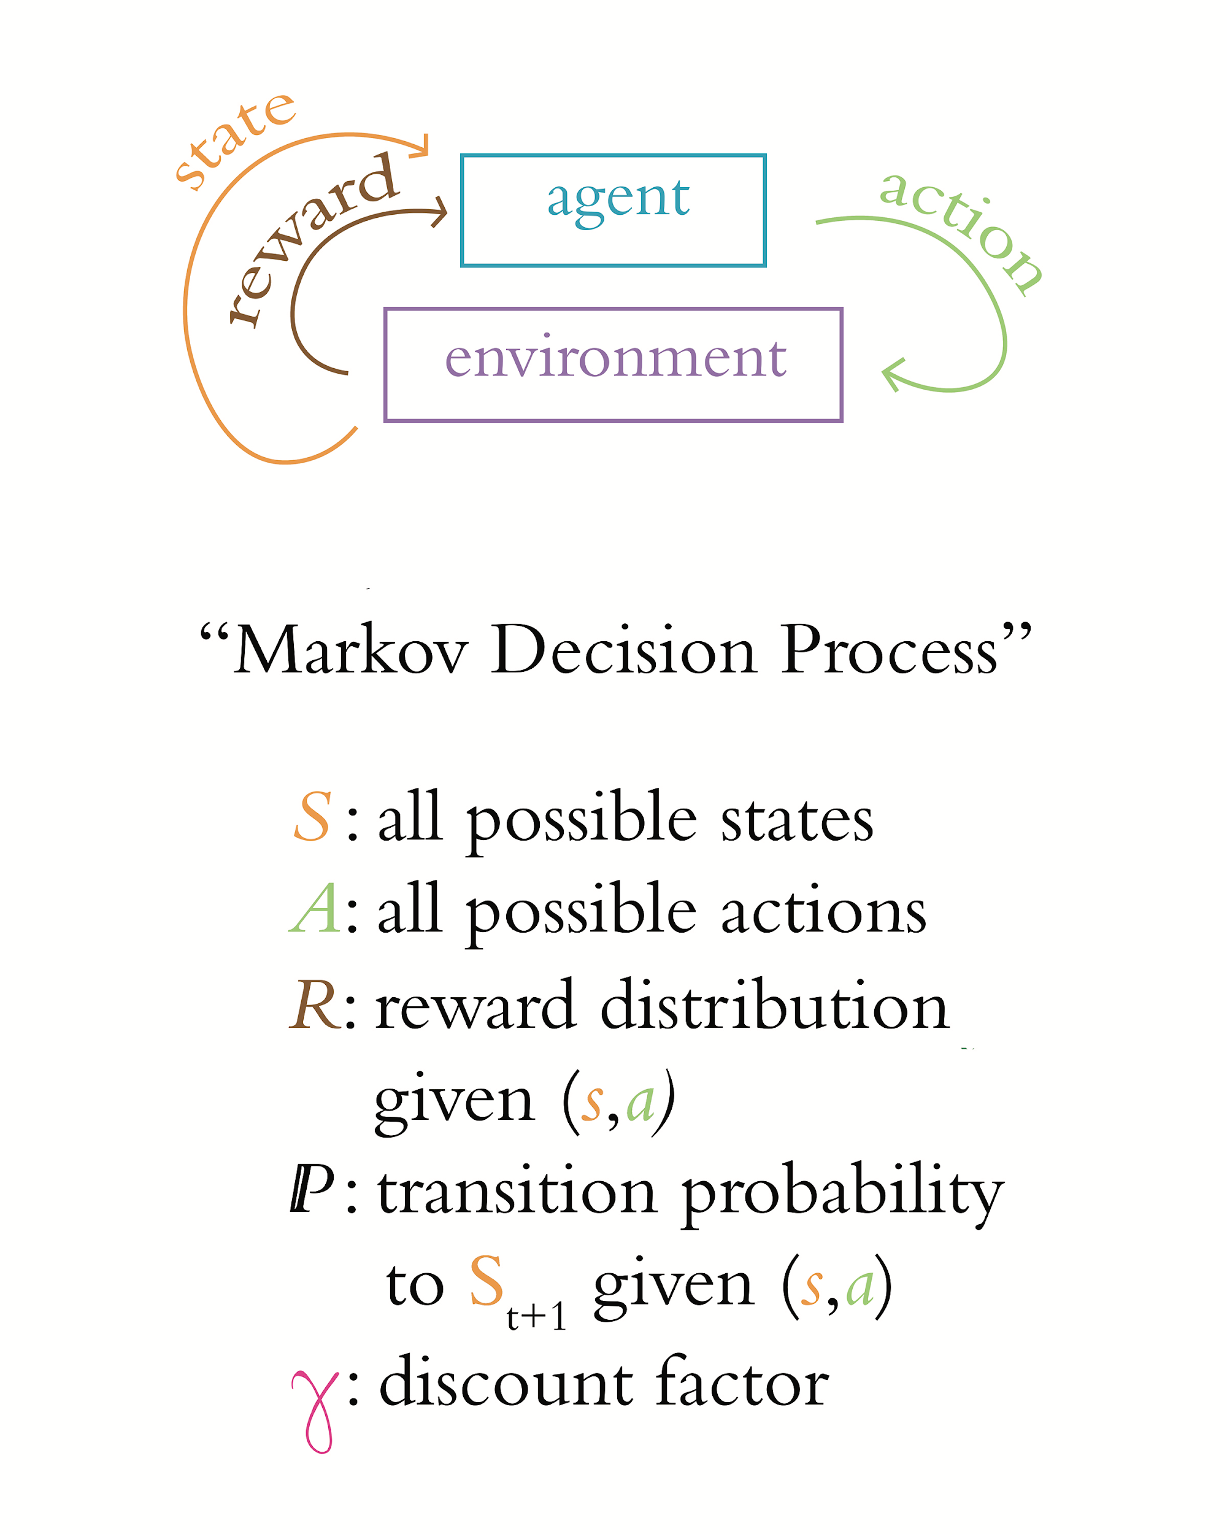
Chapter 13
Deep Reinforcement Learning

Slide 69
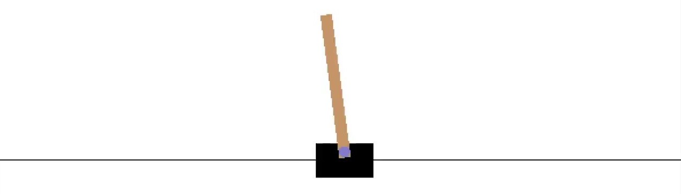
The Cart-Pole Game

Slide 70
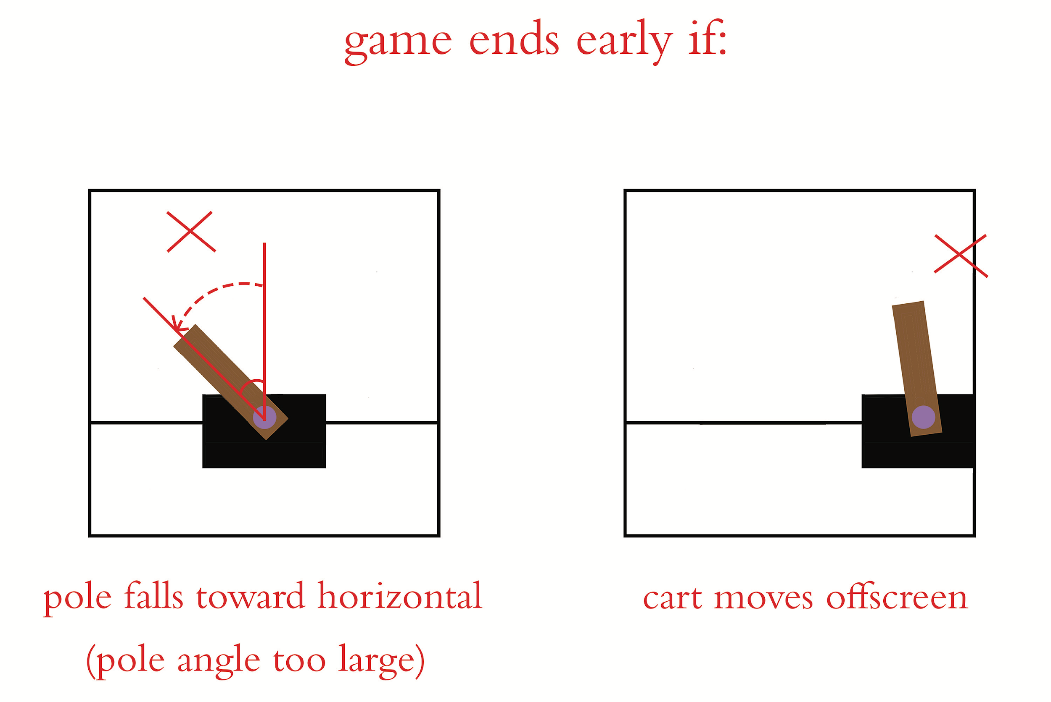
The Cart-Pole Game

Slide 71
The Reinforcement Learning Loop

Slide 72
The Cart-Pole Game
Environment States:
Cart Position
Cart Velocity
Pole Angle
Pole Angular Velocity
Actions:
Move Cart Left
Move Cart Right

Slide 73
Markov Property
Reinforcement learning defined as Markov decision process
MDP’s feature Markov property: assumption that current timestep contains all pertinent information about state of environment from previous timesteps.

Slide 74
Markov Decision Process

Slide 75
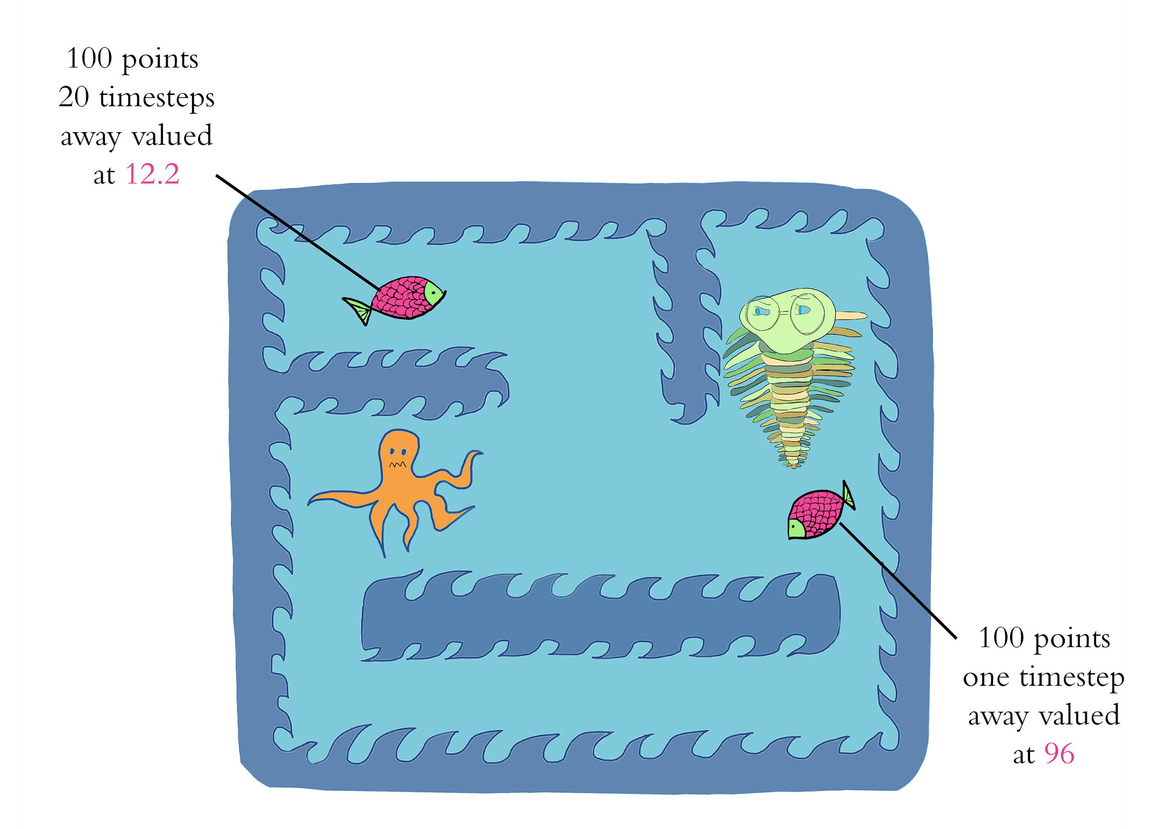
Discount Factor gamma

Slide 76
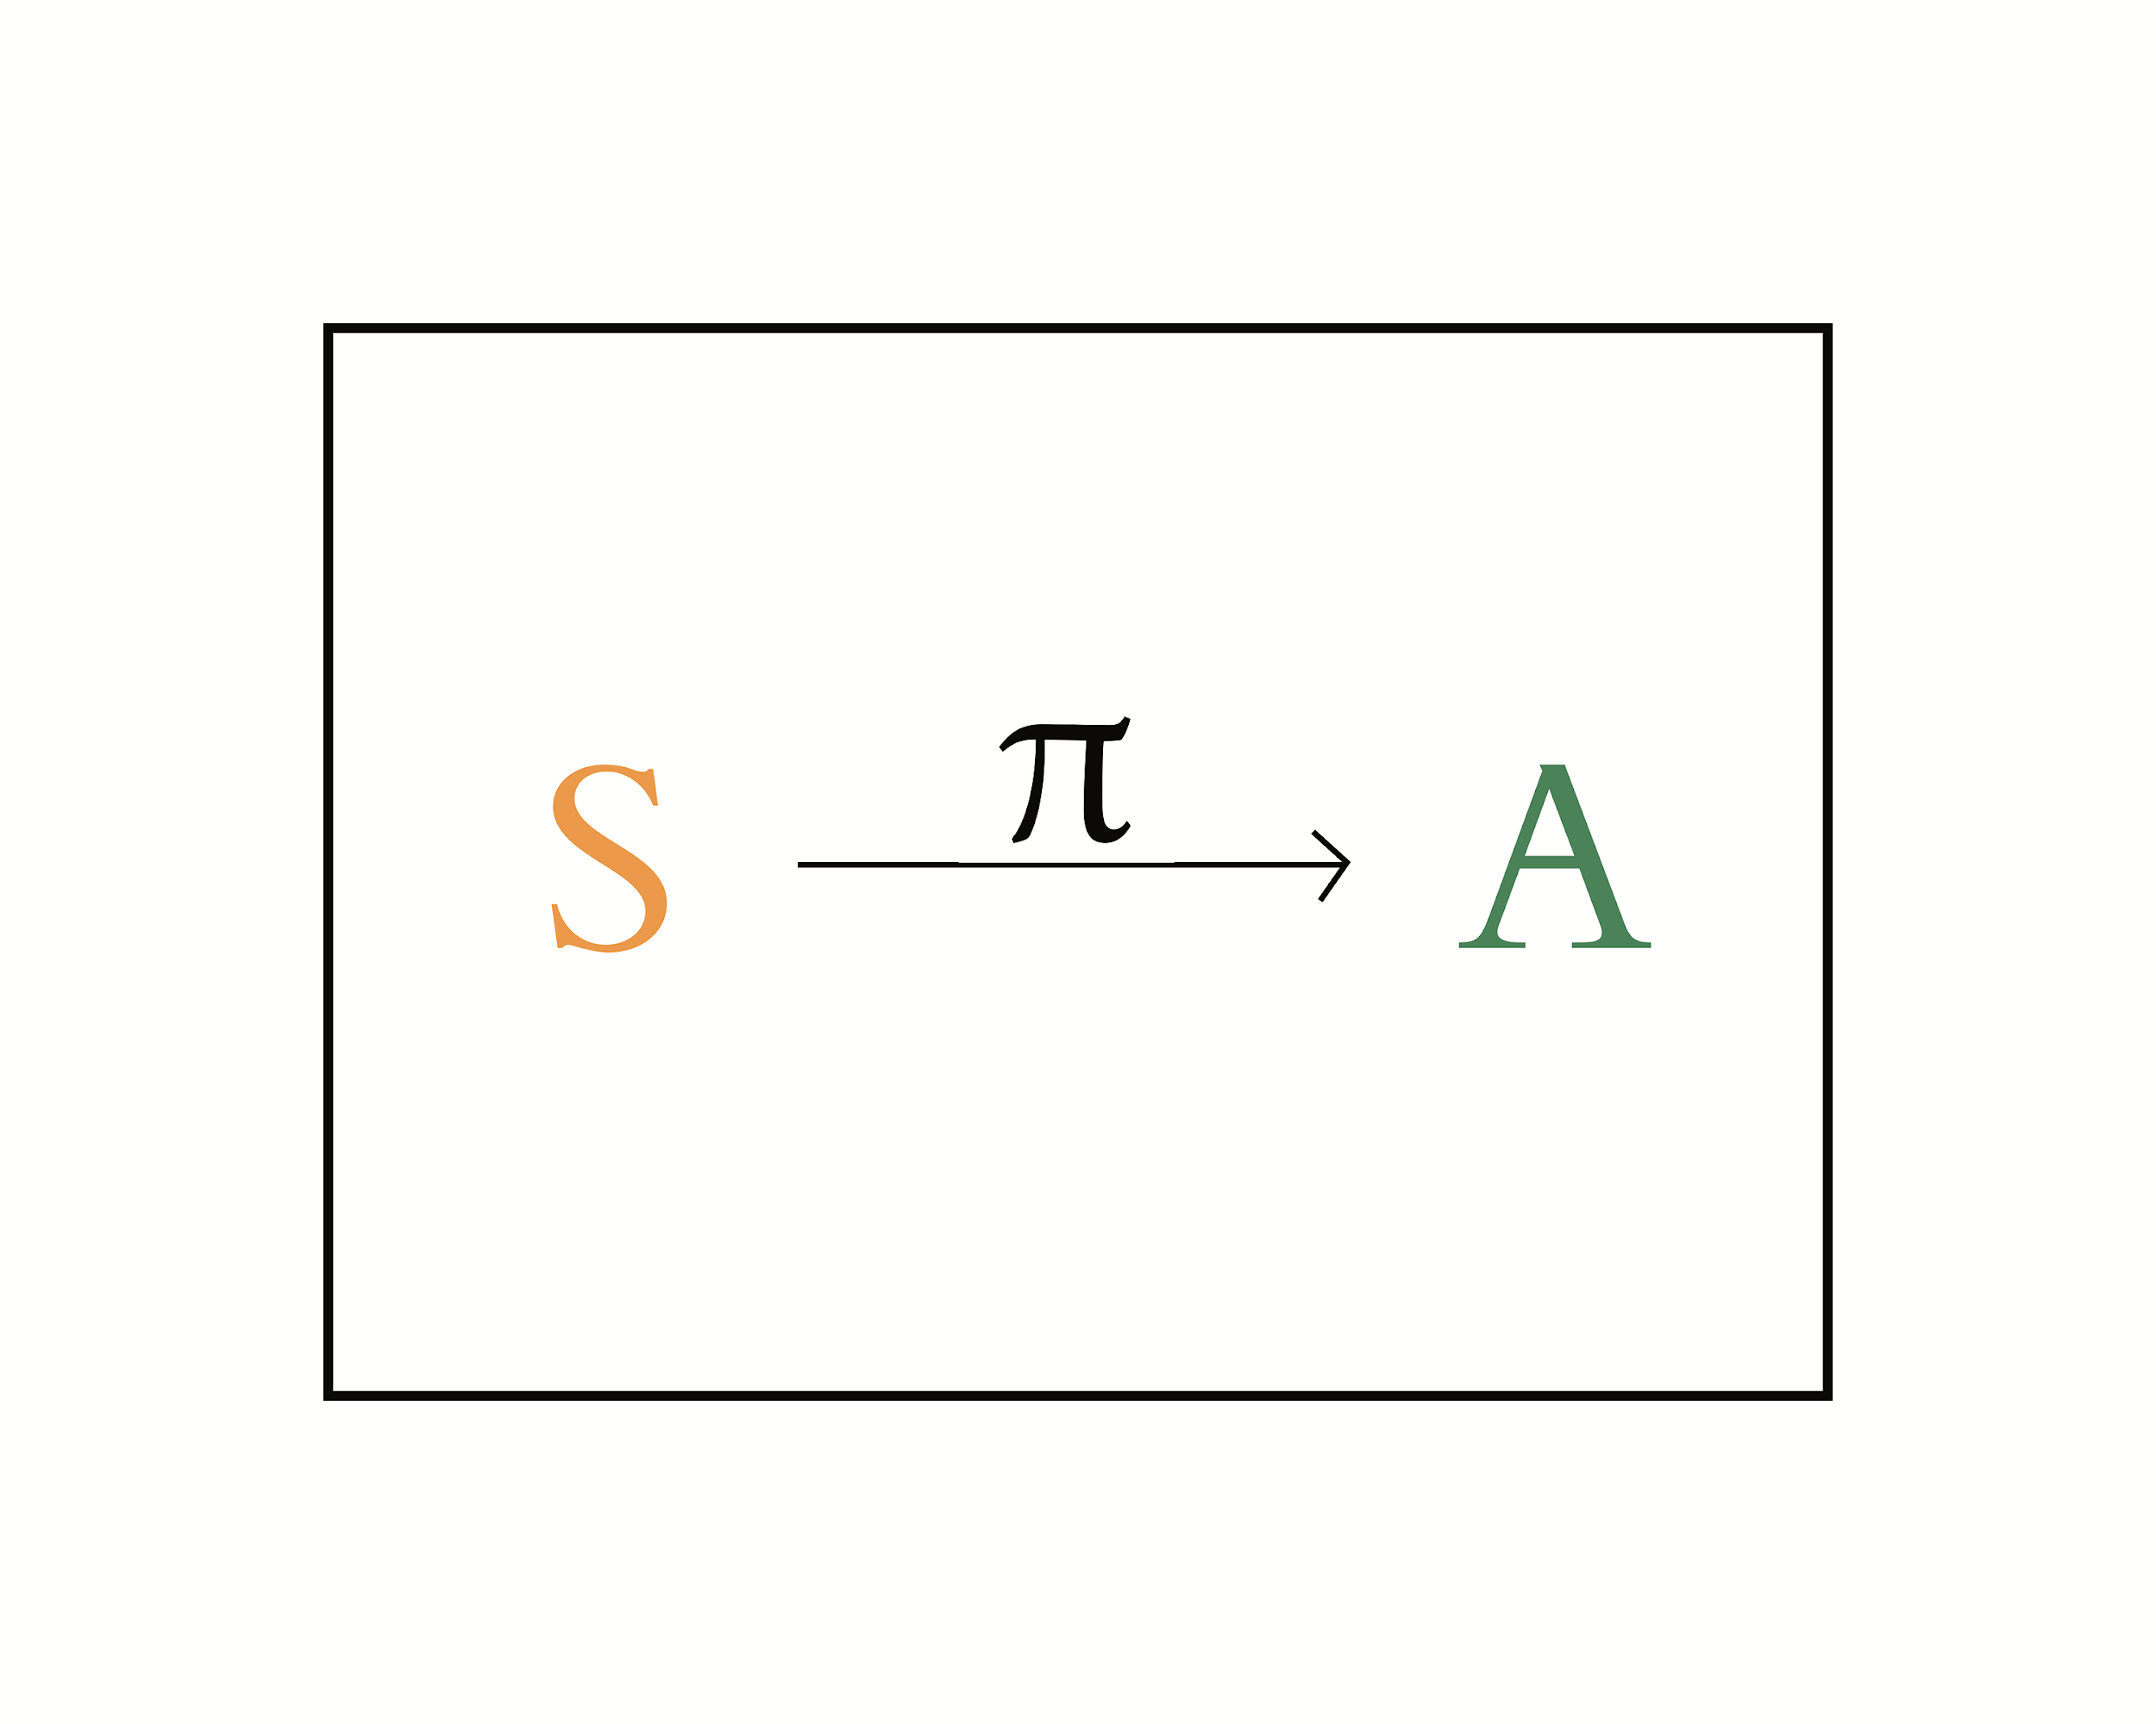
The Optimal Policy
Objective of MDP → find function that enables agent to take appropriate action when it encounters a particular state
Policy Function: agent learns function that enables it to map S to A
Enables agent to select action that maximizes discounted future reward

Slide 77
Deep Q-Learning Theory
Computationally inefficient to calculate the maximum cumulative discounted future reward due to all the possible future states and actions.
Q-learning Approach → computational short-cut that estimates the optimal action.
Components of Q-Learning Theory:
Value Functions
Q-Value Functions
Estimating Optimal Q-Value

Slide 78
Deep Q-Learning Network Components
Value Functions: indication of how valuable a given state is if agent follows its policy
Q-Value Functions: builds on value function by pairing action with a given state.
Estimating Optimal Q-Value: utilize deep ANNs to estimate the optimal Q-value
Computationally inefficient to calc true Q-Value

Slide 79
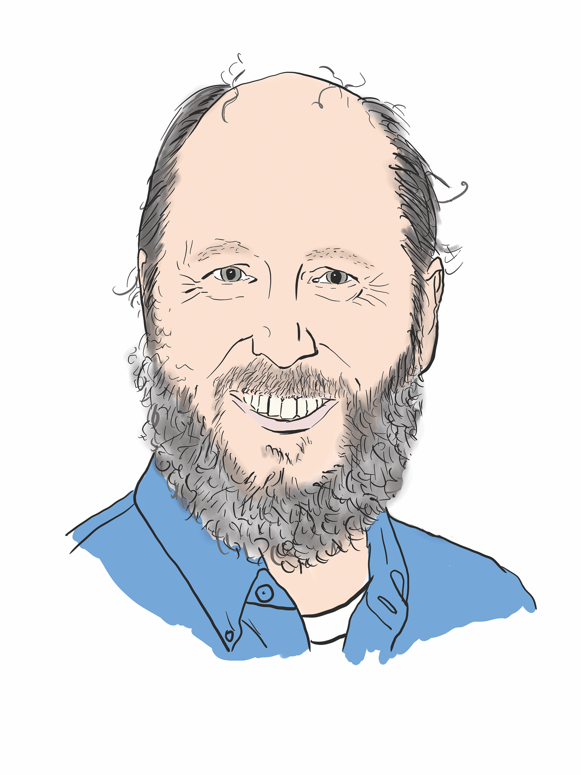
Richard Sutton

Slide 80
Applied Deep Learning
Module 10:
Chapter 13
Notes:
These are notes for the slide

Slide 81
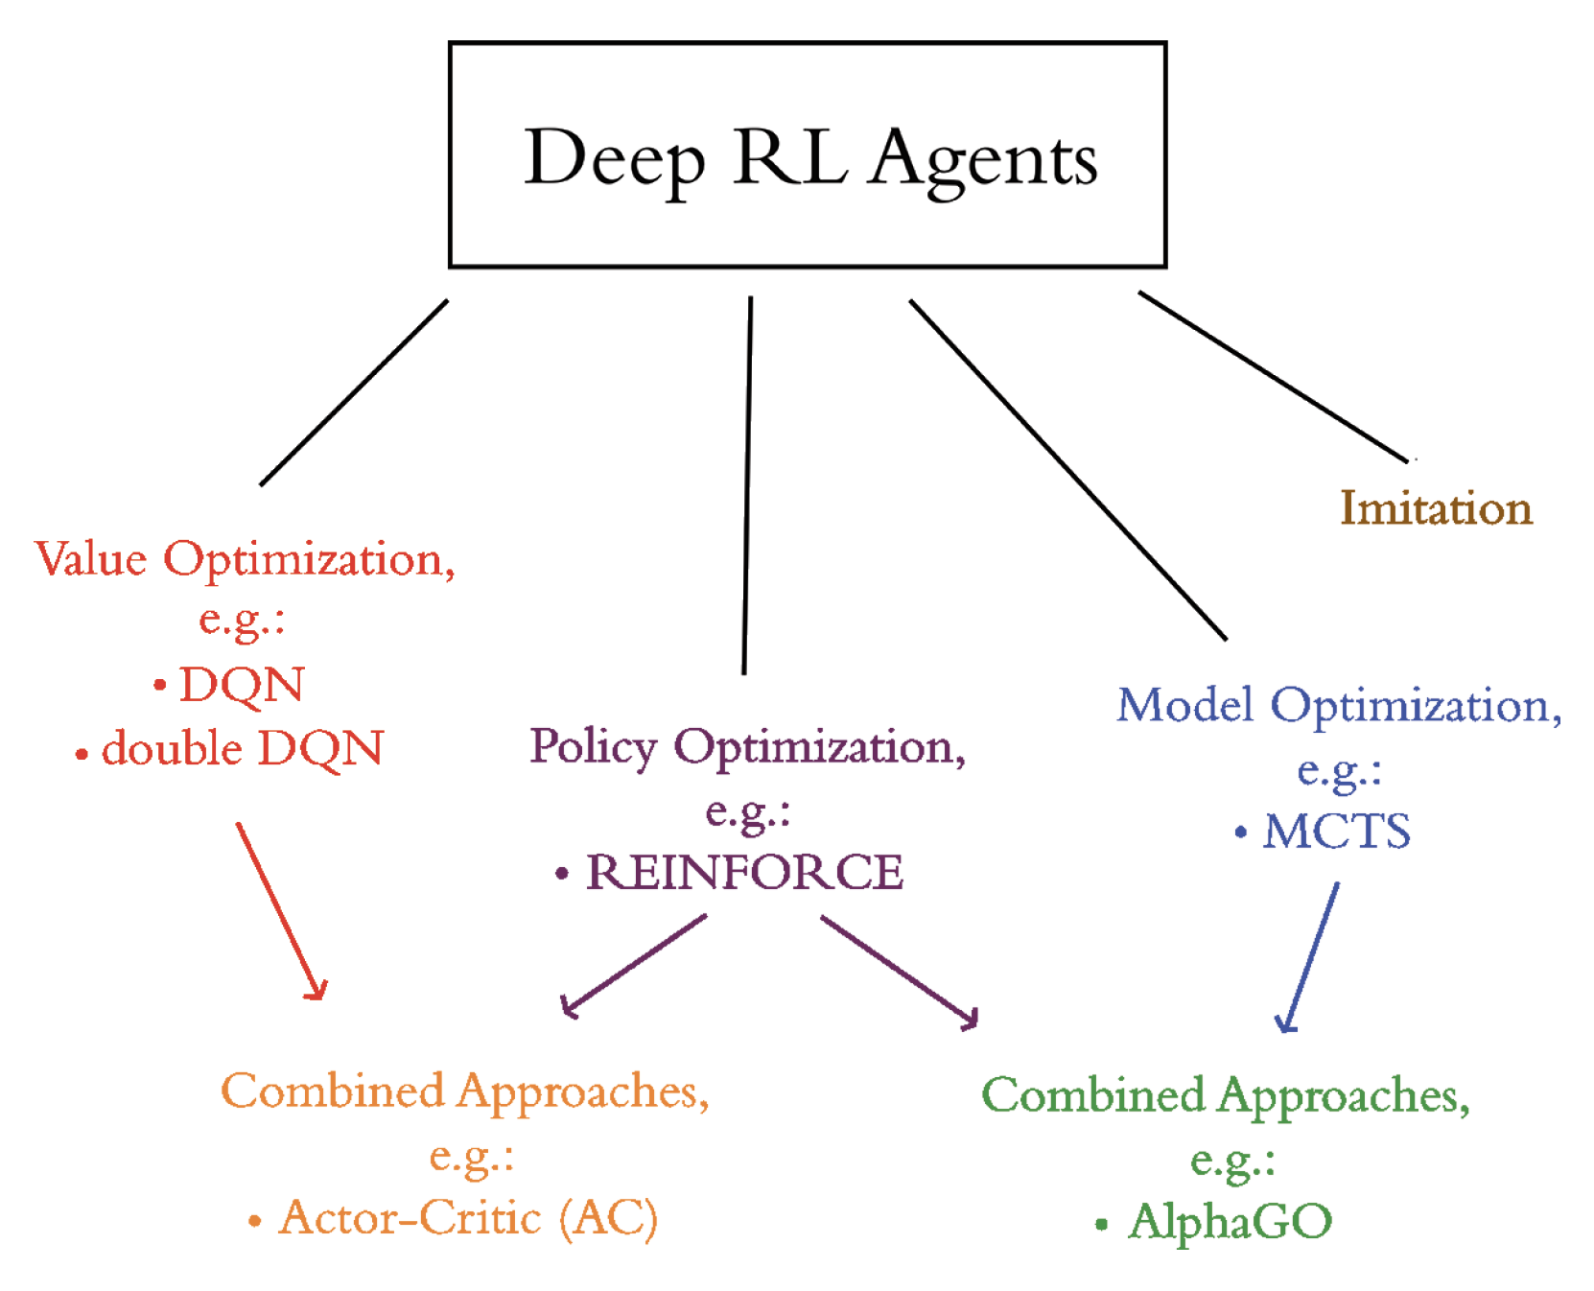
Chapter 13
Deep Reinforcement Learning

Slide 82
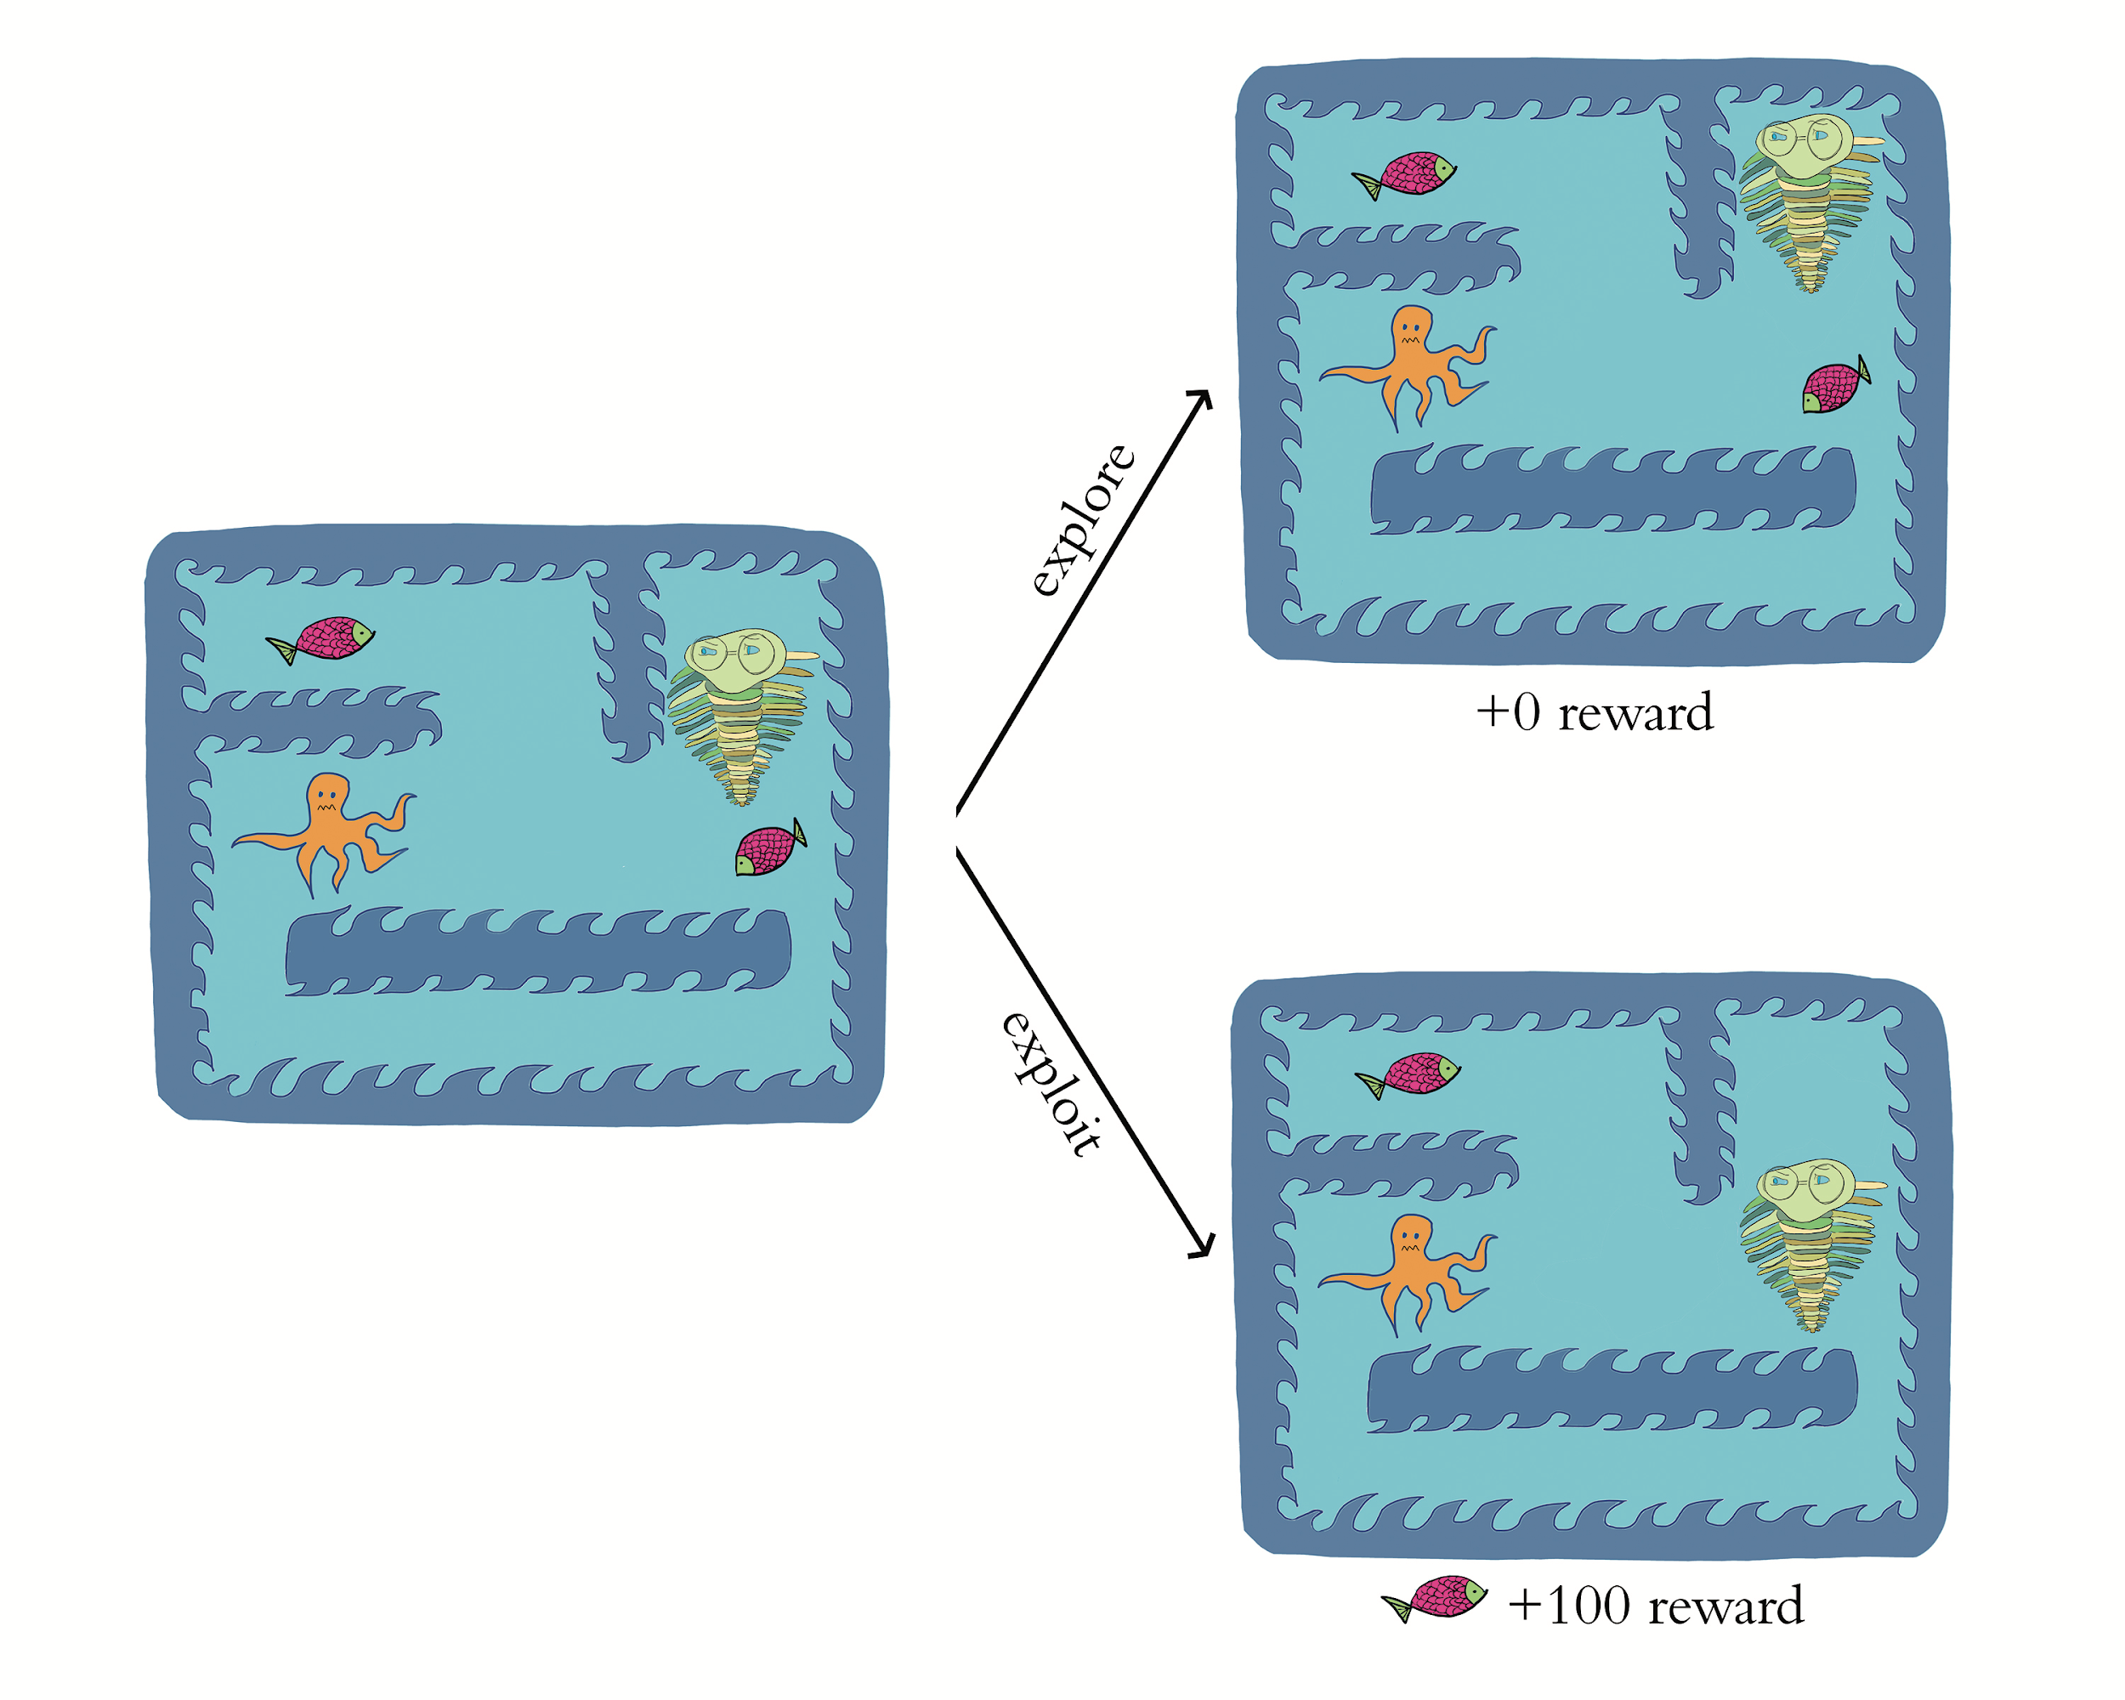
Exploration Rate epsilon

Slide 83
SLM Lab Features
Ready-Made Deep RL Agents
Modular Agent Components
Various Environment Libraries
Multiple Environment Libraries Simultaneously
Performance Benchmarking
Hyperparameter Tuning

Slide 84
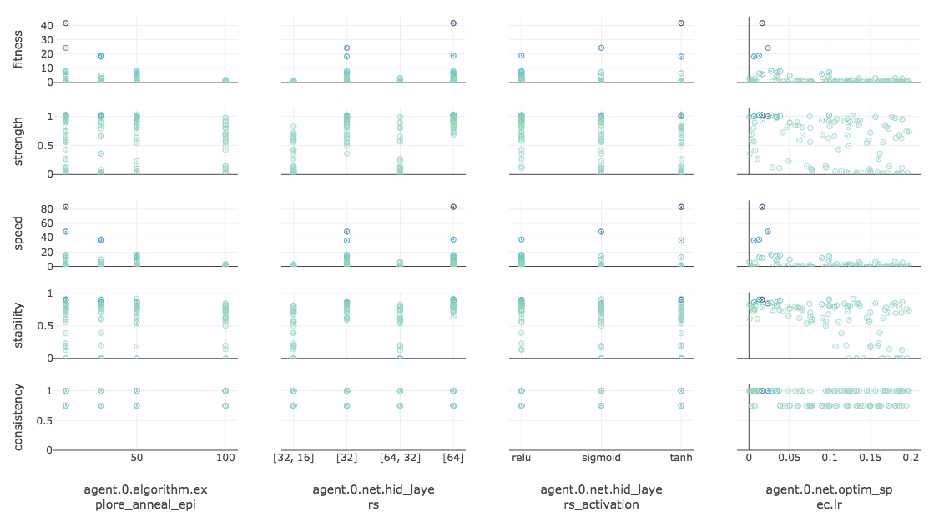

Slide 85
Deep RL Agent Categories
Value Optimization
DQN agents: solve RL problems by optimizing value functions
Imitation Learning
Behavioral cloning: designed to mimic behaviors taught to them
Model Optimization
Learn to predict future states based on (s,a) → MCTS (AlphaGo)
Policy Optimization
Policy Gradients: learn policies directly
Gradient Ascent→ maximize reward, not minimize cost

Slide 87
Combined Approaches
AlphaGo
Combined Model Optimization & Policy Optimization
Actor-Critic Algorithm
Combined Value Optimization & Policy Optimization
Combines Q-learning & Policy Gradients
Loop that alternates between Actor & Critic
Actor → a PG algo that decides what action to take
Critic→ Q-learning algo that critiques the action & provides feedback on how to adjust
Solves broader range of problems than DQN and lower variance of performance than REINFORCE
Reminiscent of GAN’s

Slide 88
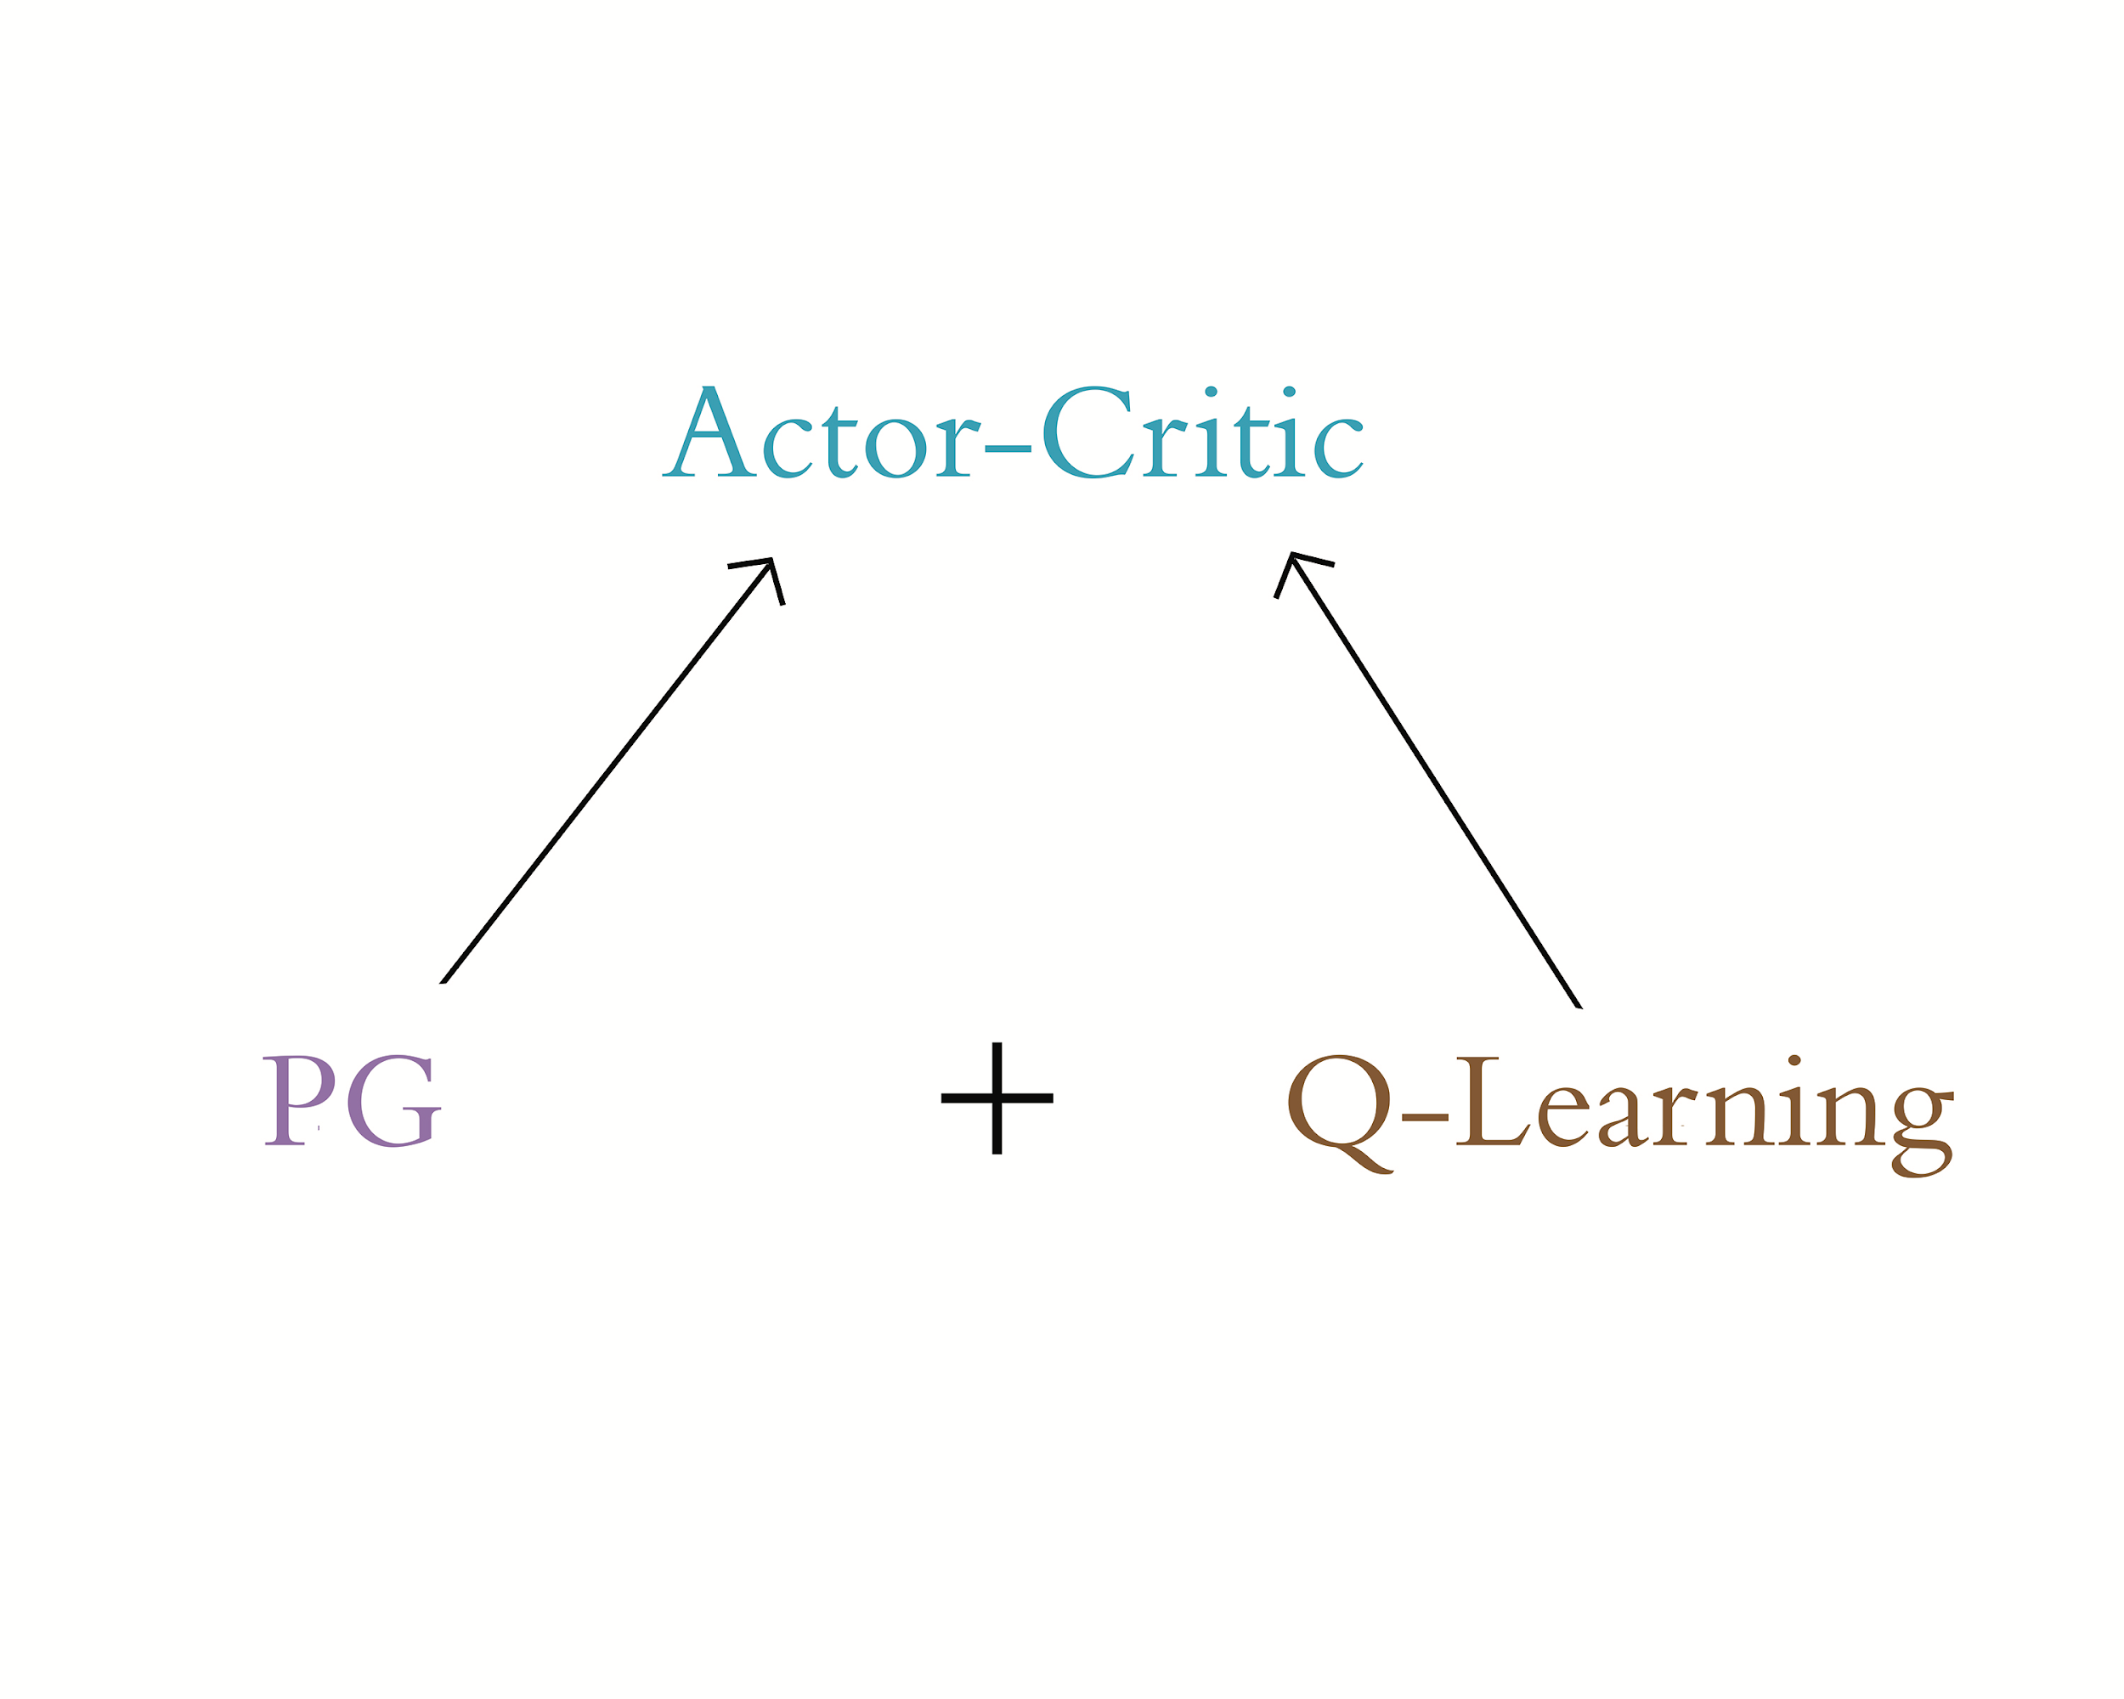

Slide 89
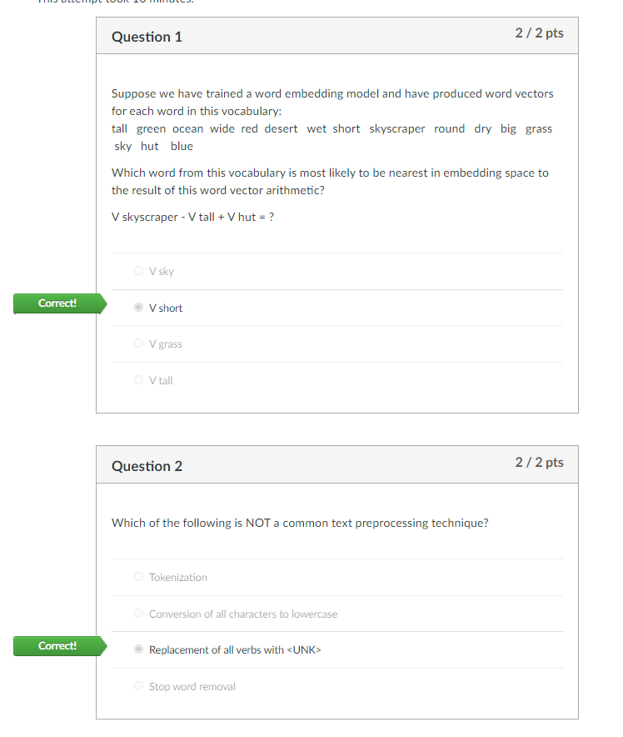
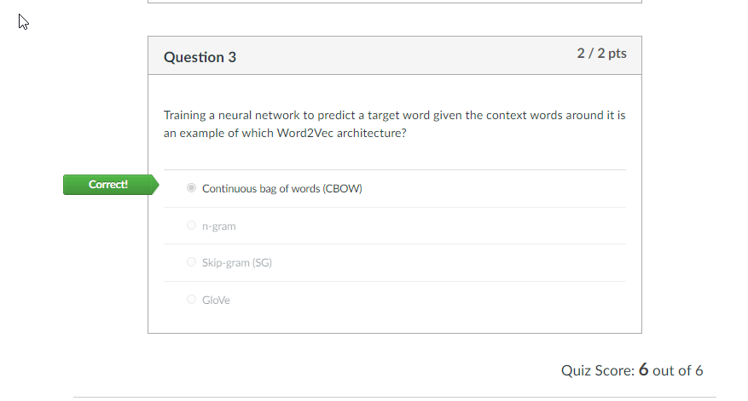

Slide 90
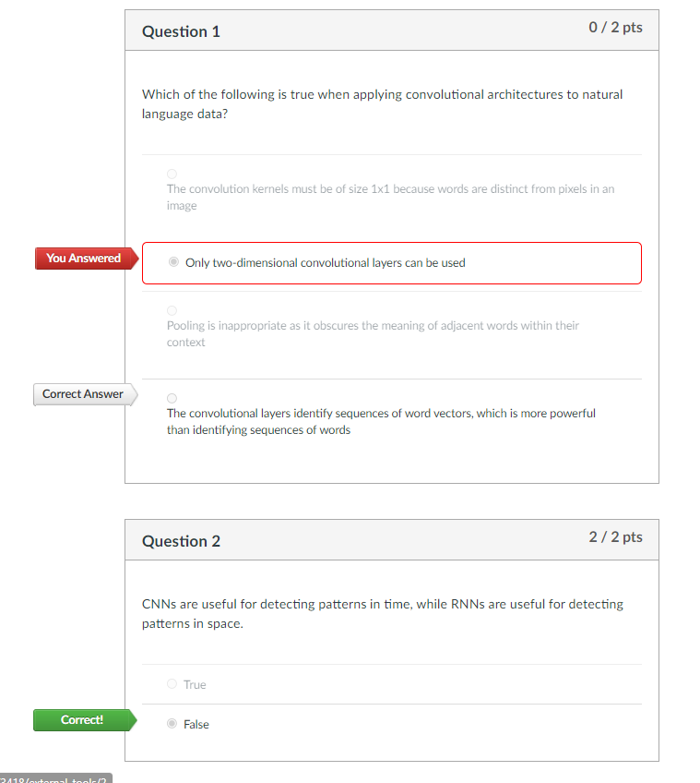
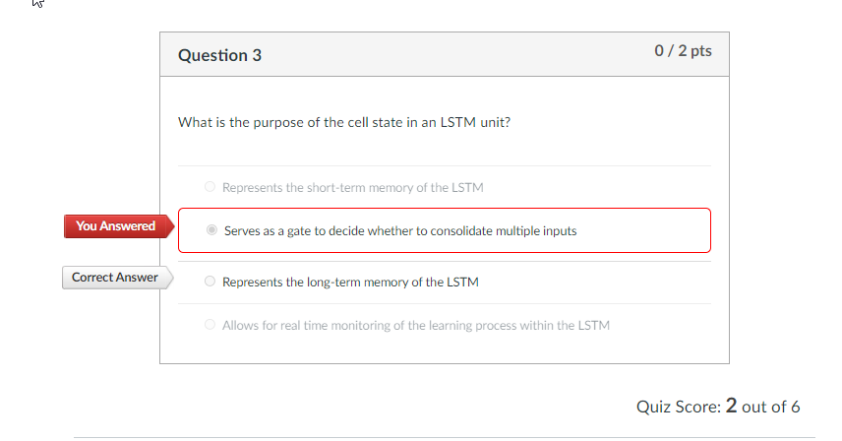

Slide 91
